Slide 1
Engaging our Colleagues with Lutheran Tradition in Higher Education:
Capacity-Building through Collaborative Infusion

Slide 2
Key questions:
Why do you want to engage your colleagues with your institution’s Lutheran tradition?
Recruitment? Inclusion? Distinctiveness? Mission-affinity? Alumni engagement?
Where are there opportunities for engagement that fit your “why”?
Who are your natural partners for these opportunities?
4. How can you support that partnership?

Slide 3
Where are there opportunities for engagement?
Ongoing:
Hiring process – job posting with links, prompt for candidates (benefits readers)
Admissions – website, tours, communications with families
Advisor training – frame for discussions about vocation (NSSE item!)
Orientation – new year-long staff orientation program
Post-orientation – mentorship programs (faculty/staff), first-year experience
Tenure/promotion dossier – candidate statements reflecting on mission
Annual review/performance evaluation – question about contributions to mission
Alumni programming – sessions at homecoming/reunion, book groups

Slide 4
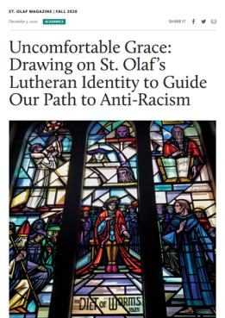
Where are there opportunities?
Ad hoc:
Strategic moments:
Mission statement revision
Board of Regents Visioning Task Force
Curriculum revision
Equity and inclusion work
Professional development
Advancement/alumni relations
Co-curricular programs and speakers
Examples: Patel, Duncan, Green

Slide 5
Who are your natural partners?
Human Resources (job postings, staff orientation)
Admissions staff
Chief Diversity Officer/Equity and Inclusion staff
Student Life staff (student orientation, co-curricular programming)
Faculty developers (faculty orientation, chair training, curriculum revision, advising, pedagogy)
Task Forces and committees (mission revision, equity and inclusion work)
Advancement and alumni staff

Slide 6
How can you support that partnership?
It helps to have a hub!
Website with key links and documents
“Tag lines”
Moodle or other course management platform
Retreat/seminar/workshop
Consultations with Marketing and Communications
“Always reforming”

