Slide 1
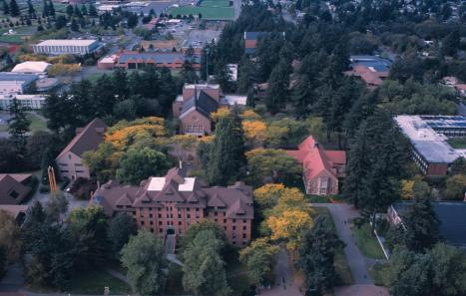
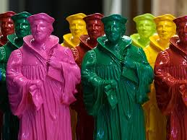
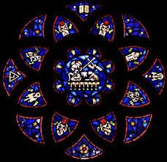
Pacific Lutheran University
Lutheran Higher Education
Rigorous Education
Liberal Arts
Care for the World
Dr. Marit Trelstad, Professor of Religion and University Chair of Lutheran Studies
Professor of Religion

Slide 2
Hello Colleagues of our Network of ELCA Colleges and Universities!
I share this PowerPoint to:
share our context at Pacific Lutheran University
share forms of introduction to Lutheran Higher Education that we offer at PLU and
provide an example of a LHE presentation offered at the first session of New Student Orientation for students and their family members
provide sample slides that would be added or used for faculty, staff and administration presentation

Slide 3
Context of PLU
Our context: Have to define Lutheran Higher Education in a way accessible to our context:
a secular & religiously-diverse
Institutionally-suspicious PacNW
LHE is sometimes sensed to be competitive with diversity, justice and sustainability because:
Increasingly a context where all things religious are assumed antithetical to diversity, justice and equity rather than being integral to it: Lutheran = white supremacy
Dismantling the institution and history Can be seen as the work of students, administration and faculty – our common work may become transforming the institution as well as educating students for life beyond college/university
TRANSLATION OF LUTHERAN CONCEPTS AND COMMITMENTS and THE HISTORY AND VALUES OF LUTHERAN HIGHER EDUCATION is essential
Cannot assume any familiarity with theological ideas or language

Slide 4
Annual University Chair of Lutheran Studies work in Introducing LHE to Staff, Administration, Faculty and Students:
3-4 Orientations to LHE for all new staff and administration for Human Resources
2-3 Sessions on LHE with all New Faculty – one-two during orientation and a follow up seminar later in their first year
New Student & Parent Orientation – LHE presentation on first session of orientation day
Admissions Office Ambassadors (student tour guides) and staff orientation on LHE;
As a part of their training, student tour guides are tested on their presentation of LHE and how they work it into their tour
Our Wild Hope Center for Vocation (which is related to but beyond my work as University Chair of Lutheran Studies) and its Wild Hope Programs.
Wild Hope Center for Vocation Student Fellows – student fellowship on vocation that meets weekly – studies LHE history and practice at PLU and concentrates on Vocation and infusing conversation about vocation among students
Faculty and Staff seminars /cohorts to meet, read and discuss LHE and how it intersects with their work (Samuel Torvend and Sergia Hay led this) – these were annual for some time; cohorts built around this
Annual Lutheran Studies Conference (the page goes to this fall's conference but "History of the Conference" includes all past conferences and speakers) This year, we piloted a pre-conference session for pastors, through the office of Congregational Engagement. Involves speaking and leadership from various faculty, offices and students on campus.
Special Presentations to committees and administrators (examples below)
Faculty Joint Committee
Core Curriculum Committee
Academic Identity Statement / Long Range Planning Committee
Presidential Search Committee
Provost and President
“Active” (engaged) forms of Introducing LHE

Slide 5
“Passive Forms” of Introducing LHE:
passive in the sense that they are printed or online resources
1. Videos used for University Conference (all faculty/staff), New Student/Parent Orientation, and other venues:
Because We're PLU(1:34 total)
What will you bring? Lutheran Higher Education (4:20 total)
2. Podcasts in cooperation with Campus Ministry:"Because We're Lutheran" Podcasts.
3. Core Elements of Lutheran Higher Education Used all over campus and now a part of our
4. Academic Identity Statement Approved by Faculty Assembly that affirms Lutheran Higher Education as central and also references the Network of ELCA Colleges and Universities (NECU) "Rooted and Open" as foundational to PLU.

Slide 6
Various introductions with different emphases
New students/Admissions
Quick
Easy to remember
Mnemonic devices (CALLS)
Really brief history of Lutheran Higher Education
Explains Liberal Arts
Highlights values of LHE at PLU
New Faculty / Staff / Administration
Adds:
Context of Pacific Northwest and PLU’s history
Describes culture of:
Our Institution (strong faculty governance, democratic or egalitarian sensibilities)
The Region
Faculty & Staff relations
Faculty and Administration
Adds:
PLU documents and their emphases
ELCA documents on Higher Education and NECU
Values
Curricular emphases related to mission
More on Liberal Arts & their history in ancient times, LHE & today

Slide 7
Sample PowerPoint follows – used for student orientation
LHE ”cheat sheet” in reading materials for the Introducing LHE conference (June 2021) is an item I will sometimes hand out or include in packets as a summary of basics covered in faculty, staff and administration presentations and Q & A times
(Some slides may be unclear without being presented.. Not created for “passive” sharing)

Slide 8
Pacific Lutheran University
Lutheran Higher Education
Rigorous Education
Liberal Arts
Care for the World
Dr. Marit Trelstad, Professor of Religion and University Chair of Lutheran Studies
Professor of Religion

Slide 9
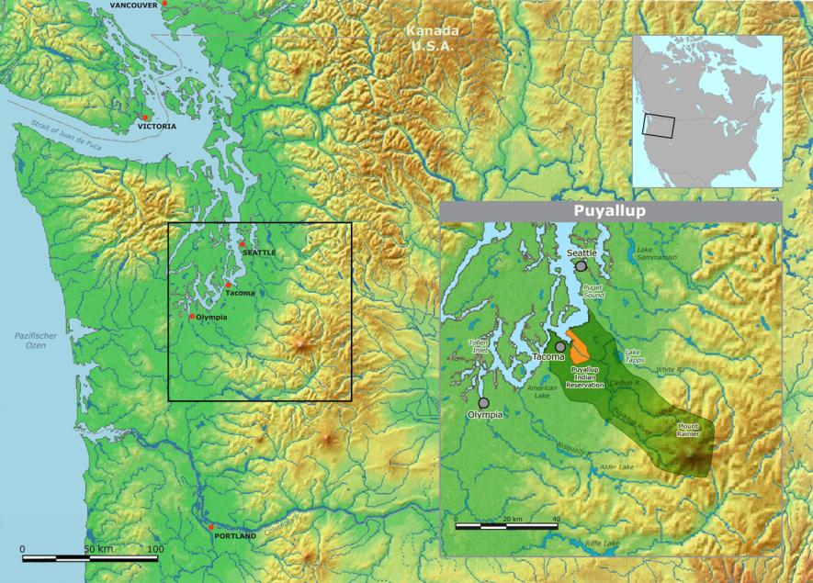
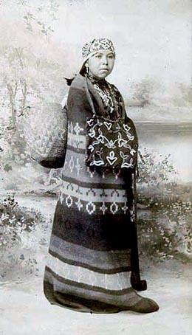
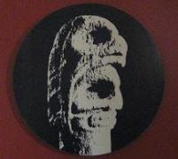
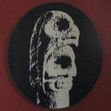
We are on the traditional lands of the Nisqually, Puyallup, Squaxin Island and Steilacoom peoples; we acknowledge and respect the traditional caretakers of this land.
Steilacoom Tribe
Coast Salish People
PLU is on traditional Tribal Land

Slide 10
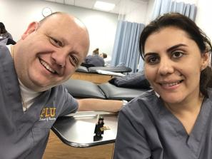
PLU “CALLS”
Emphasis on Questioning provides PLU a unique mission emphasis among colleges and universities!
Critical Inquiry / Questioning
Access to learning for all
Liberal = Liberating Education
Leadership
Service as one’s call and purpose

Slide 11
OUR EDUCATIONAL HISTORY: An expansive, global memory shaping contemporary learning
Shaped by:
Greek philosophy
Roman legal study
Rabbinic argumentation
Christian monastic schools
Muslim advances in architecture, the arts, and healthcare
Medieval universities
Renaissance humanism
Lutheran reform of education: freedom, access, commitment
Enlightenment advances
Tradition of U.S. private liberal arts colleges and universities
Openness to Chinese and Indian learning

Slide 12
Lutheran Higher Education: Origins in Germany in the 1500s

Slide 13
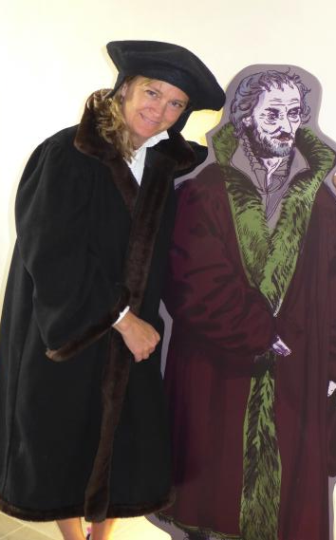
Martin Luther and Philip Melanchthon Founders of Lutheran education

Slide 14
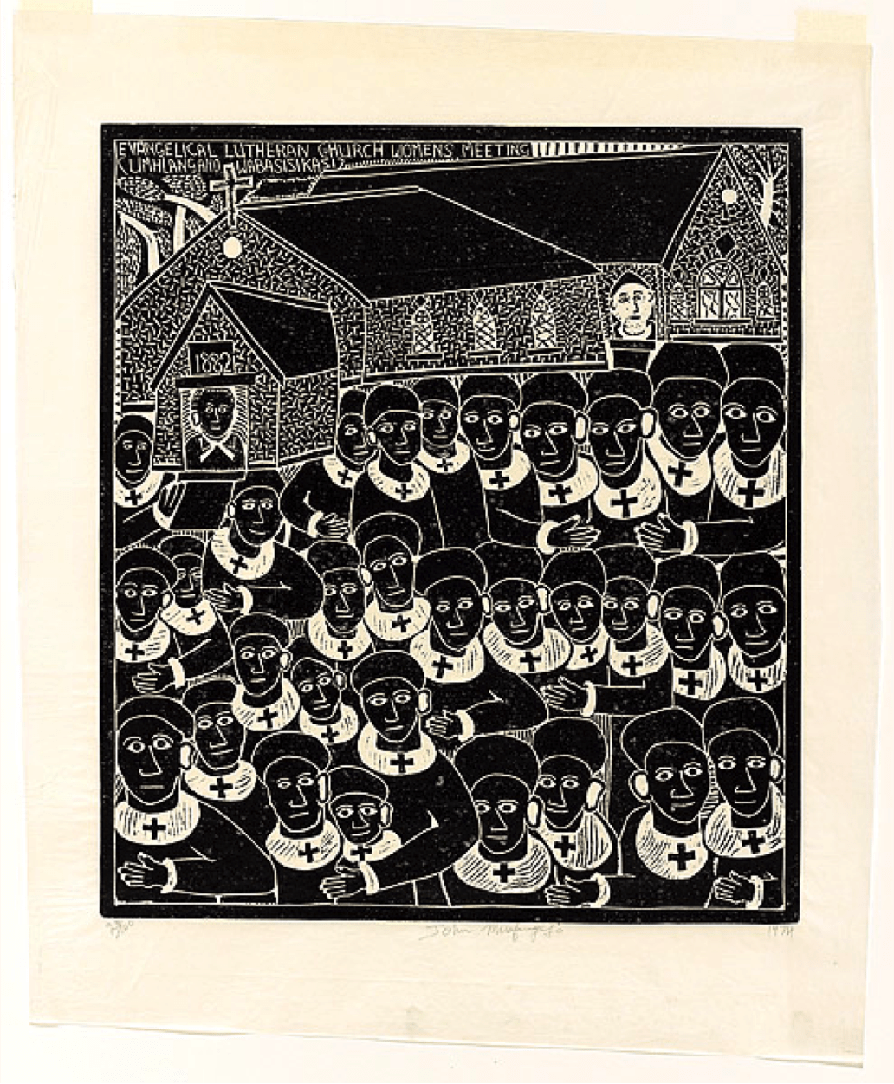
LUTHER – Monk and University Professor
Education and study led him to expose corruption and offer new ideas :
Believed in the inherent integrity of all persons, loved in the eyes of God
Critiqued social and church systems that oppressed the poor and vulnerable
Affirmed Equality of all callings / vocations in the world

Slide 15
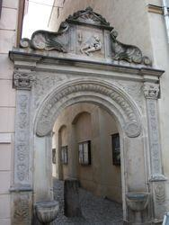
University of Wittenberg founded in 1502
Some of Luther’s Innovations:
Developed a unified, written German Language
Outreach via new Technology: Media & Printing
Music - participation of all, not just experts in singing
Theology – emphasis on equality, freedom and service to others
Questioning authority, tradition and corruption
Democratization of knowledge, information, the church,
Educational reform!! : public education

Slide 16
The Lutheran reform of education at the University of Wittenberg
1. Education for men and women [first time in human history!]
2. Education for all persons regardless of socio-economic status
3. Education funded by the state through graded taxation
4. Incorporation of the humanities in university learning:
history, languages, literature (including poetry), ethics
5. Rigorous questioning of the status quo, received tradition
6. Promotion of academic freedom for sake of advancing
knowledge through research, experimentation, performance
7. Education for leadership in society to diminish human suffering and injustice
Notes:
Critical Questioning / Inquiry
* academic freedom and deep knowledge
* questioning status quo, received tradition that pushes the edges of what we know now
* engaging tradition and shaping the future
Access to learning for all
Liberating Education: liberal arts = freeing power of education
Leadership in society to..

Slide 17
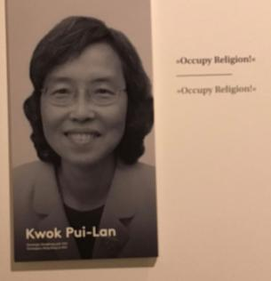
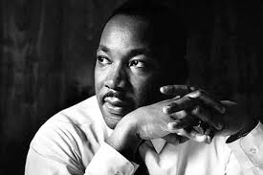
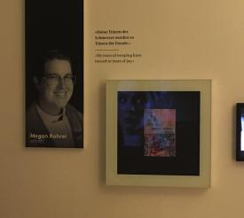
500th Anniversary of this Reformation Oct 31, 1517 – 2017
Celebrations around the world : e.g. “95 People” exhibit in Wittenberg, Germany feature contemporary and historic figures who carry on reforming work today along the lines of Luther: Steve Jobs, Friedrich Nietzsche, Martin Luther King Jr., Kwok Pui Lan, Meghan Rohrer, Johann Sebastian Bach, etc.
Luther is not a hero but seen as a revolutionary model

Slide 18
The spread of Lutheran education
By the end of the 1500s
PINK = Lutheran Protestants
GREEN & PURPLE: Other
Protestant Traditions
YELLOW = Catholic

Slide 19
Locations of Lutheran Colleges & Universities
26 are specifically ELCA Colleges and Universities, including PLU

Slide 20
From its start, Lutheran Higher Ed was based on the Liberal Arts
Because the Reformers experienced the freeing power of education based in history, languages, philosophy/theology, etc. they stressed that Lutheran Higher Education is rooted in the liberal arts.
THESE WERE CONSIDERED ESSENTIAL FOR EDUCATION OF FREE PERSONS and CIVIC LIFE GENERALLY – liberating or freeing education – freeing from past models/frameworks
In Greek and Classical Education, 7 liberal arts are:
1. The 3 “trivium” foundations : grammar, logic and rhetoric
2. The “upper division” 4 “quadrivium”: arithmetic, geometry, music and astronomy

Slide 21
Liberal Arts Today
The liberal arts spectrum is generally accepted as covering the following fields:
Humanities – includes art, literature, linguistics, philosophy, religion, ethics, modern foreign languages, music, theater, speech, classical languages (Latin/Greek) etc.
Social sciences – includes history, psychology, law, sociology, politics, gender studies, anthropology, economics, geography, business informatics, etc.
Natural sciences – includes astronomy, biology, chemistry, physics, botany, archaeology, zoology, geology, Earth sciences, etc.
Formal sciences – includes mathematics, logic, statistics, etc.

Slide 22
Liberal Arts and Lutheran Reform
To the 7 classical liberal arts, Luther and his contemporaries added the heart of the Hebrew Prophets who emphasized justice and human values.. they added poetry, ethics, and the study of languages… which was at the root of their reform.
At PLU:
Liberal arts are not just distribution boxes to check.
The Humanities, Mathematics, Social and Natural Sciences are the Foundation on which we build our professional programs; They are the basis for a well-educated life of learning committed to care.

Slide 23
Norwegian Lutheran immigrants in the Pacific Northwest

Slide 24
Scandinavian cultural sensibilities
An egalitarian ethos
Earthiness: down-to-earth; care for the earth
A communal orientation
Intellectual modesty and charity
A strong work ethic
High regard for education
Commitment to social welfare and international peace

Slide 26
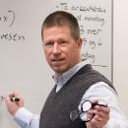
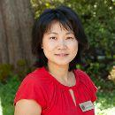
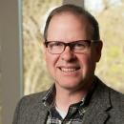
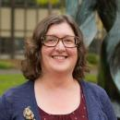
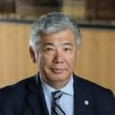
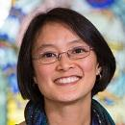
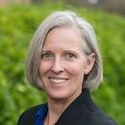
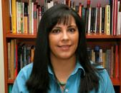
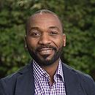
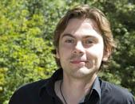
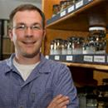
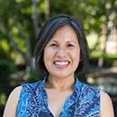
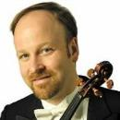
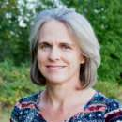
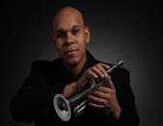
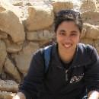
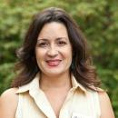
PLU faculty Today

Slide 27
The educational mission of PLU
Values and Commitments

Slide 28
PLU’s MISSION
Educating for lives of thoughtful inquiry, service, leadership, and care –
for others, their communities, and the earth

Slide 29
A University of the Evangelical Lutheran Church of America :
What does this mean?
Commitments to Diversity, Justice & Sustainability:
Service to Neighbor and Earth
Value-laden education: service and community orientation
Accompanied by the ELCA, one of the more progressive church bodies in our country
Fearless pursuit of education and questioning
Valuing the academic study of Religion as necessary for a humane, peaceful world & reflection on one’s deepest values and commitments

Slide 30
“For you are powerful, not that you may make the weak weaker by oppression, but that you may make them powerful by raising them up and defending them.
You are wise, not in order to laugh at the foolish and thereby make them more foolish, but that you may undertake to teach them as you yourself would wish to be taught." - Martin Luther
Luther’s reflections on the purpose of education

Slide 31
What this university is
An educational community committed to:
teaching, scholarship, and service
global education, faculty-student research
purposeful learning & vocation
diversity, social justice, and sustainability

Slide 32
What this university is not
A smaller version of a research university
A private school for elites in the PNW
A church school for the intellectually timid
It does not equate religious affiliation (Native Religions, Buddhist, Jewish, Muslim, Hindu, Christian, and more) with:
a lack of the best, contemporary rigorous scholarship;
an anti-intellectual/anti-science stance
We welcome you to bring your whole self to your education!

Slide 33
The educational Mission and Vocation of PLU:
Committed Education
Commitment to rigorous education through critical inquiry
Commitment to fostering student reflection about the meaning and purpose of their education in service with the world

Slide 34
PLU: Core Elements of Lutheran Higher Education emphasize:
1. Critical questioning of current knowledge and values
2. Freedom for expression and protection of learning
3. A liberating foundation in the liberal arts
4. Learning and research within community
5. The intrinsic value of the whole creation
6. Discerning one’s vocation in the world
7. Service to the advancement of life, health, and wholeness

Slide 35
Rigorous Education
Care
Challenge
Justice
Support
The Lutheran reformers taught that education is for something: not only the advancement of knowledge but also a commitment to the alleviation of suffering. Thus, a Lutheran education is inextricably linked to promoting life, health, and wholeness for others, other-than-human creatures, and the earth itself. Our commitment to the promotion of peace and a just and sustainable society flows from such a commitment to wholeness.
Questioning
Scholarship
Sustainability
Diversity
Faith

Slide 36
WELCOME TO PLU!
WE ARE PASSIONATE AND EXCITED ABOUT YOUR EDUCATIONAL JOURNEY
AND LOOK FORWARD TO SHARING OUR COMMUNITY & THE ADVENTURE OF LUTHERAN HIGHER EDUCATION WITH YOU!

Slide 37
The following slides are samples of material that may be included for various staff, faculty and Administration LHE Presentations. For example, rooting it in the key documents from PLU’s documents (35+ years) and ELCA documents on Higher Education

Slide 38
Pacific Lutheran University
Lutheran Higher Education
Rigorous Education
Liberal Arts
Care for the World
Dr. Marit Trelstad, Professor of Religion and University Chair of Lutheran Studies
Professor of Religion

Slide 39
Sources for this Presentation
FROM PLU:
Academic Identity Statement (2019)
PLU 2000 (1995)
PLU 2010 (2003)
PLU 2020 (2012)
Strategic Plan (2020)
Diversity, Equity & inclusion Strategic Plan (2020)
Core Elements of Lutheran Higher Education
Principles of General Education
FROM ELCA:
“Rooted and Open: The Common Calling of the Network of ELCA Colleges and Universities” (2018)
Faculty working groups of NECU scholars
ELCA Social Statement on Education (2007)
Caution: loads of religious language – not mine but from the documents; “Philosophy of Lutheran Higher Education” was used first in PLU 2020.

Slide 40
We know who we are and what we are doing; it is a coherent and passionate form of Lutheran Higher Education that is repeated over and over since 1993 and before.
LUTHERAN HIGHER ED is the Special Sauce. It is a distinctive curricular ecology that highlights these elements that are integrated across the curriculum:
Vocation – Purposeful learning and living
Thoughtful inquiry, leadership and care across the curriculum
Liberal Arts – rooted and adaptive for the future
Rigorous Disciplinary knowledge + Interdisciplinary work to challenge and innovate
Rooted in values and commitments while being open to reformation and innovation
Protecting intellectual freedom
We stumble and resist when asked to prioritize one value or one program over others because it is an ecology.

Slide 41
How has this shaped Lutheran Higher Ed in the US Liberal Arts Colleges & Universities?
LITERACY AND ACCESS FOR ALL TO EDUCATION regardless of gender, socio-economic status, race, ability, culture, religion, etc.
LIBERAL ARTS AND EXPOSURE TO MULTIPLE DISCIPLINES & THEIR METHODS: Liberal Arts foundation as a basis for pre-professional and professional fields comes from the very start of Lutheran Higher Ed at the University of Wittenberg in Germany and this commitment is reflected in all of PLU 2000, 2010, 2020 and General Principles . PLU has stated the value of both disciplinary and interdisciplinary education.
NURSING, EDUCATION & MUSIC - They have LONG held prominent commitments and are known for excellence in nursing and music (PLU added BUSINESS right from the start). The professional and pre-professional programs were understood as means by which one uses ones education for the betterment of others & the world. This comes from a theological understanding that one is given gifts (love and grace) in order to serve the neighbor. Opportunities and privilege are expected to be used.. Thus our mission: an education “FOR lives of thoughtful inquiry, service, leadership and care.”
THE ACADEMIC STUDY OF RELIGION has been required to offer “religious literacy” (Rooted and Open) toward more humane and understanding world. Lutheran Higher Education began in the academic study of Religion and it has been a leader in this area for centuries. It is distinct in its approach to the study of Religion because it offers critical analysis and methods (not always found in more orthodox, religiously-affiliated studies of religion) in tandem with appreciation/valuing of religion as integral to 95% or more of the world’s self-understanding (not always found in secular universities - welcoming all religious traditions and other secular bases for deep values). It has been defined as a “third path” approach in many Lutheran Higher Ed publications. In a society that lacks tools and training to critically analyze one’s own and other religious claims, this is a distinct gift of this form of education – affirmed by 88% of the PLU faculty at faculty assembly in the 2019 Gen Ed conversations.
Fun fact: PLU pioneered offering courses in world religions before any other ELCA school and it is still the one that balances introduction to Christian & Beyond-Christian Global Religious Traditions. It is the direction that most of our sister schools are now trying to go in.
TENURE & FREEDOM OF INQUIRY: The US development of the tenure system is based off of the protection and freedom of research and expression mandates arising from Luther’s reformation. This was a part of Protestant universities that insisted that the best conditions for scholarship occur under situations free of coercion.

Slide 42
The university draws from its cultural and religious roots in the Renaissance and Reformation the belief that education expands possibilities for meaningful life and work and for contributing to a more just and equitable society [PLU 2010]

Slide 43
Key repeatedly affirmed elements in PLU document’s descriptions of Lutheran Higher Education:
Liberal Arts & education from many distinct perspectives & disciplines:
A commitment to deep disciplinary knowledge while also engaging interdisciplinary approaches – it values both
Pre-Professional and Professional Schools are rooted in this Liberal Arts context and the commitments of Lutheran Higher Education
Vocation: Meaning & Purposeful Education – it is an education for thoughtful inquiry, service, leadership and care and this vocational emphasis is to be embedded across all aspects of a PLU education
Diversity, Justice and Sustainability – Diversity, Equity and Inclusion have been emphasized as necessary since at least 1993. Lutheran Higher Education’s values and educational program of engaging multiple perspectives are necessary for thoughtful inquiry, leadership, service and care
Education for and welcoming the whole person – body, mind, and spirit (includes their religious or secularly-grounded commitments); all of these are emphasized
Critical questioning in all disciplines is central – a unique emphasis on the value of a good question
Global emphasis is distinct and valued – particularly since PLU 2020 (written in 2012) – we brag about languages, study away, global studies focus
The Academic Study of Religion is a unique hallmark of Lutheran Higher Education due to its distinct approach of combining: rigorous critique/analysis of all beliefs & traditions is combined with an appreciative empathy for the meanings, purpose and identities many people root in their religion.

Slide 44
PLU 2010 explains “what it means to be a Lutheran university” on page 4 and following as, first, an education built on intellectual freedom and Luther’s understanding that "No science [including theology] should stand in the way of another science, but each should continue to have its own mode of procedure and its own terms." Second, that is center on vocation: “Vocation connotes another level, for it means being called to deep and energizing purpose— welcomed by God into the opportunities and responsibilities inherent in creation” (5). Third, it holds that “an education at PLU has been and continues to be shaped by Luther's creative, dialectical theology relating faith to all of life” (10).

Slide 45
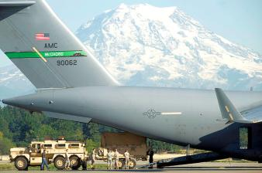
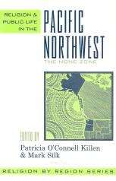
PAC NW Context
Diverse racial, cultural and religious context
Highly Secular Context : “None Zone”
Cannot assume familiarity with any religious tradition
Cultural Allergy to Institutional Affiliation
Leads to less affiliation with mainline churches and high numbers
of evangelical/non-denominational Christians
Environmental Beauty as competition & gift
Early missionaries and today
Individualistic and Non-Authoritarian
Lots of Interest in Salmon
Very large military base and presence within 2 miles of PLU

Slide 47
CRITICAL THINKING
MEANING AND PURPOSE
GLOBAL FOCUS
VOCATION
PROFESSIONAL DEGREE PROGRAMS
CREATIVE WRITING
NURSING
SUSTAINABILITY & JUSTICE
MARRIAGE &
FAMILY THERAPY
WELCOMING ALL.FAITH TRADITIONS
EDUCATION
KINESIOLOGY
Capstone
BUSINESS
MAJORS
MINORS
Nature and
Number
Living Traditions for a
Humane
Future
Human Behavior,
Culture &
Institutions
First Year Experience
The PLU Liberal Arts Core
Perspectives
on
Diversity
Arts and
Performance
LUTHERAN HIGHER EDUCATION
A purposeful, adaptive, education for a changing world

