Slide 1
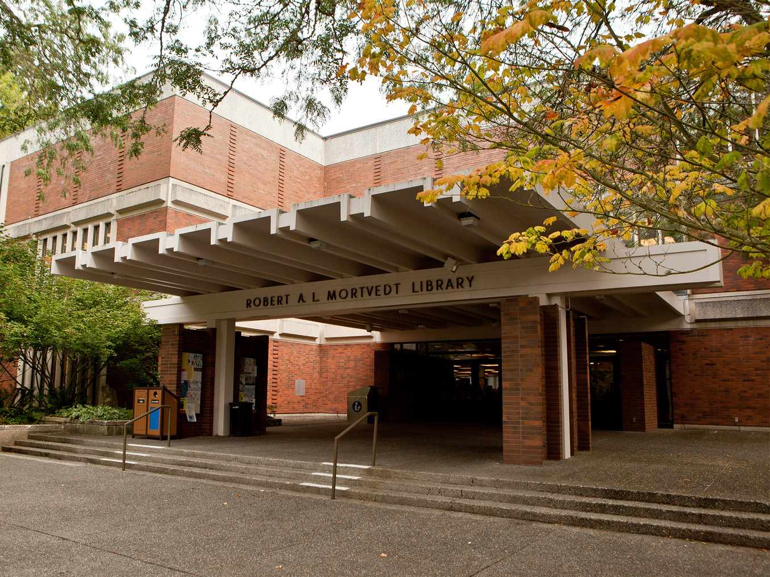
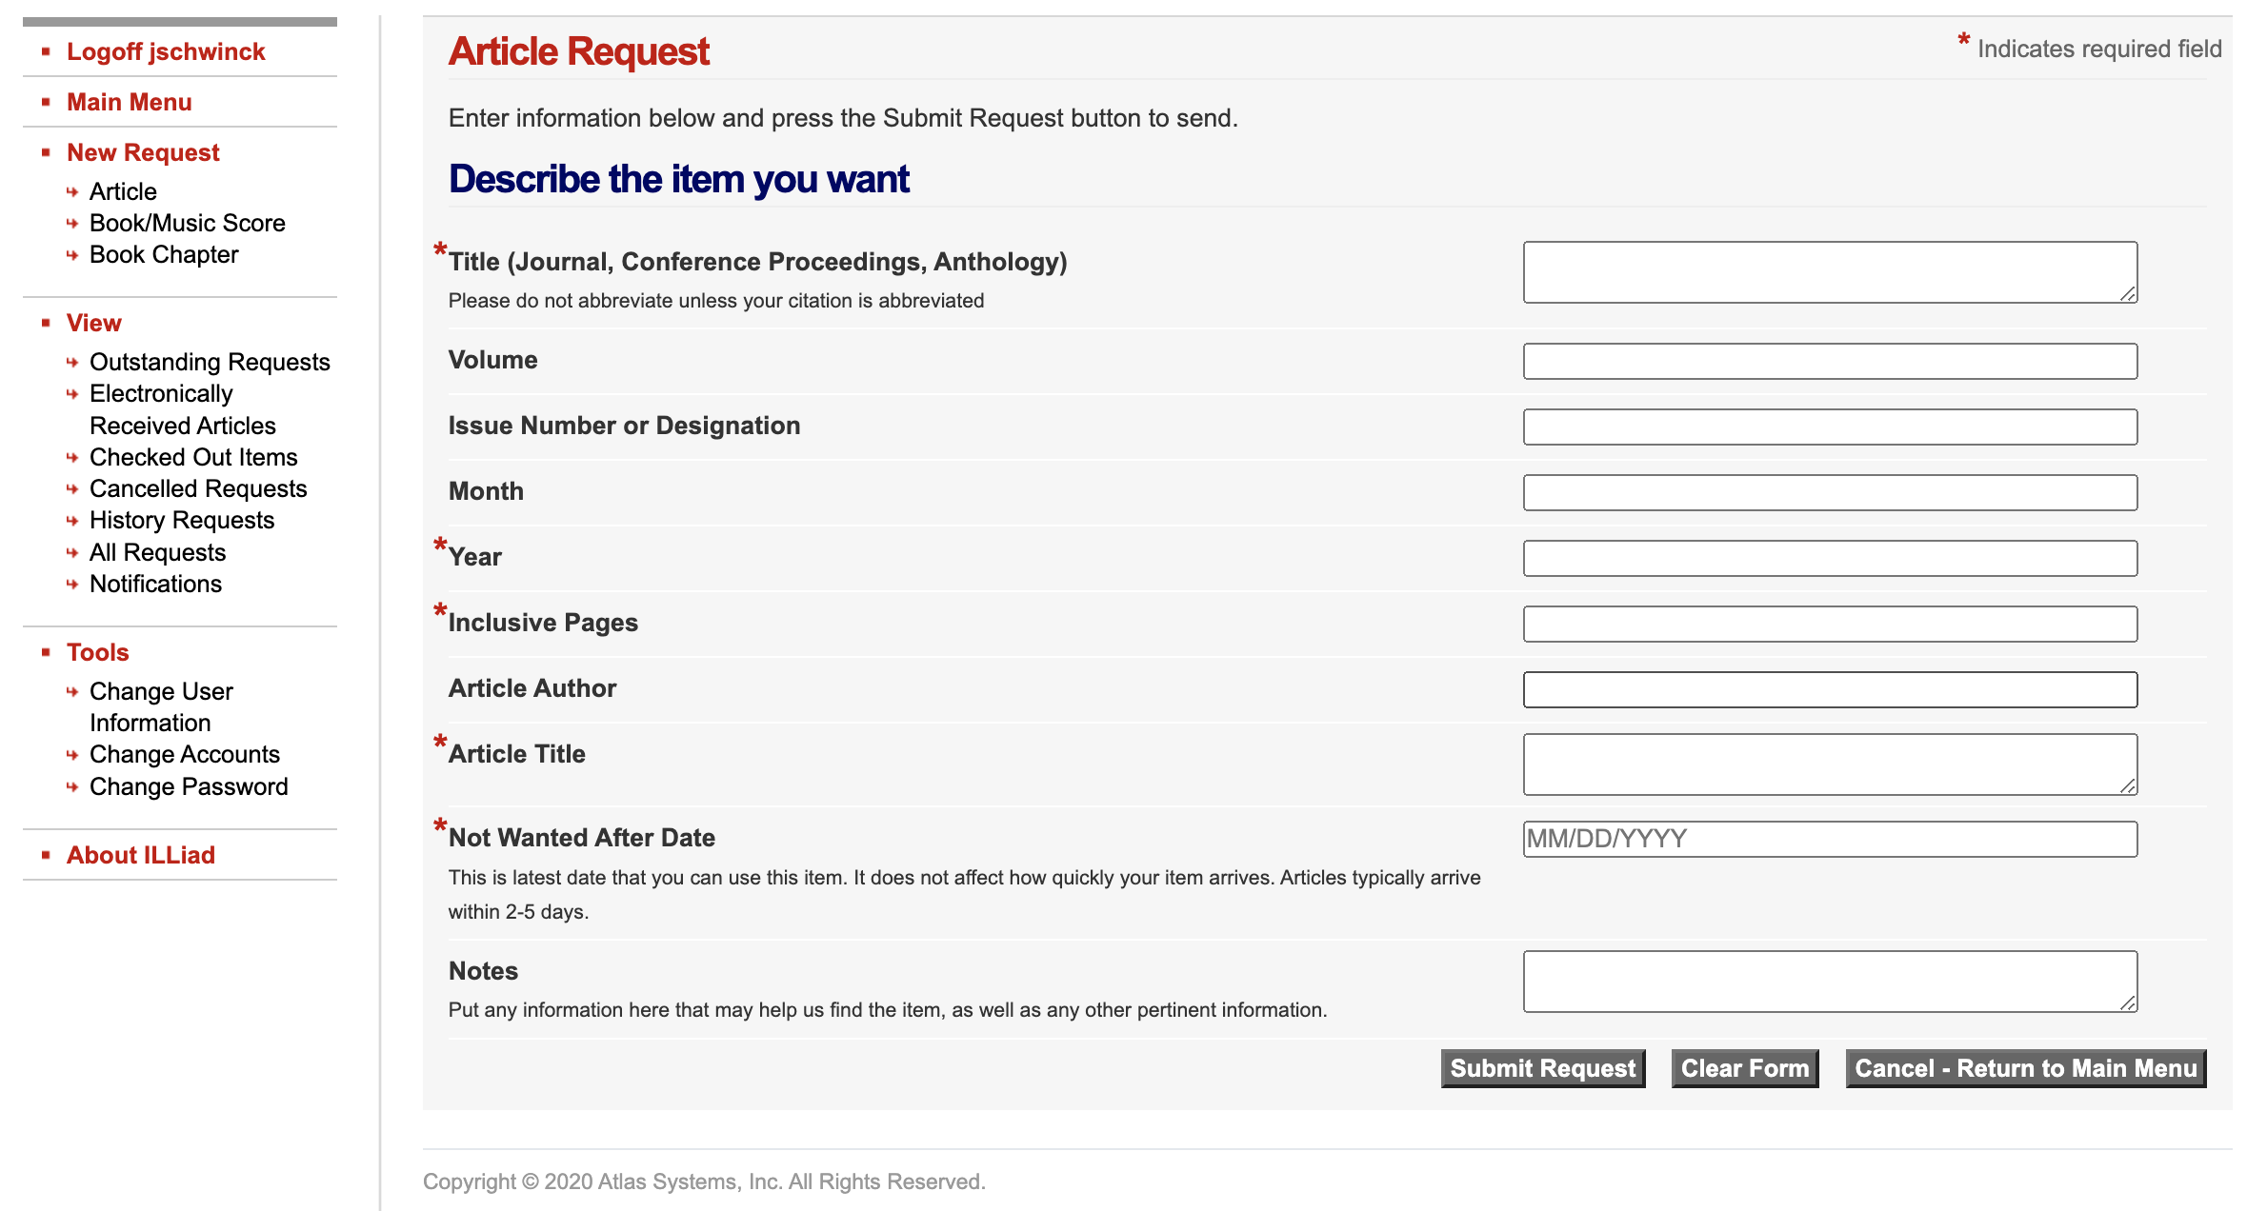
Journal Article Acquisition at PLU
A primer on how to get what you need for your Nursing Paper/Project
PLU Library
Mortvedt Library
Hours vary but typically open 7a – 10p M-Th 7a-6p F
https://www.plu.edu/library/hours/
Library staff available for consultation
School of Nursing Library Consultant: Genevieve Willams
https://guides.library.plu.edu/prf.php?account_id=21106
Available through email or scheduled appointments
Heal-WA
Heal-WA
https://heal-wa.org/
Supported by fees through your RN license
Hosted at the University of Washington Library
You will need to register and set up a UW NetID and password
https://heal-wa-org.proxy.heal-wa.org/help/getting-started/
Databases of interest:
CINAHL
ClinicalKey
Cochrane Databased of Systematic Reviews
Joanna Briggs Library
MEDLINE
Nursing Reference Center Plus
New Document Delivery Service for Heal-WA
ILL system through email with librarian
https://heal-wa-org.proxy.heal-wa.org/new-healwa-document-delivery-service/
Also a great resource for Continuing Education, Practice Toolkits
This Photo by Unknown Author is licensed under CC BY-SA
PLU Inter-Library Loan
PLU has Inter-Library Loan available
ILLiad Logon Page https://plu.illiad.oclc.org/illiad/logon.html
Additional Facts: https://www.plu.edu/library/interlibrary-loan-faq/
You will need to create an ILLiad account (this is not your PLU ePass)
Limits: 15 active requests
Most articles will be delivered electronically to your ILLiad account or PLU email
When requesting be as descriptive as possible to help with locating the article/journal
Databases
133 databases available for review
https://guides.library.plu.edu/az.php
Requires PLU ePass for access
Databases of Interest
CINAHL
Cochrane Database of Systematic Reviews
ERIC
Medline
ProQuest
PsychArticles
PsychInfo
PubMed
Questions
Reach out early to ensure you are on-track to complete your project/paper in a timely fashion. If you wait to the last minute you risk not getting your required articles in time.
Course Faculty
Librarian
Prepared by Dr. Jessica Schwinck 2022
Notes:
Library Photo: https://www.plu.edu/map/?id=1007#!m/176036

