Slide 1
Social Media Trends and How They Influence Campus Title IX Work
Subtitle
Pacific Lutheran University
Thursday, July 8th 2021
Title IX Formal Process Team and Committee Members

Slide 2
Agenda
PLU’s Policy with Social Media
How Social Media Impacts Title IX
Social Media
Dating Apps
PLU Confessions Page
Positive Impacts of Social Media

Slide 3
Our Current Policy
Pacific Lutheran University supports all of our community members taking part in social media and posting, blogging, or tweeting about their experiences. While there are great opportunities within social media, there is also the possibility of a host of unintended consequences. Pacific Lutheran University does not monitor all activity on social media; however, if social media activity that is deemed inappropriate or offensive is brought to the attention of PLU, actions may be taken. Specifically, if a social media activity is connected (either formally or informally) or tagged in reference to Pacific Lutheran University, students are expected to adhere to expectations and standards of the institution. These following guidelines are intended to help all students understand these implications and the risks associated with participating in social media.

Slide 4
If A Complaint Occurs
What Happens If a Complaint Occurs?
PLU officials will never search for social media activity by students, staff, or faculty members. However, if notification comes to PLU regarding activity that could be construed as inappropriate, disrespectful, or offensive, action can be taken. Additionally, if potential violations of the Student Code of Conduct are brought to the attention of PLU administrators, action can be taken. If activity on social media can be construed as being a representative of PLU, additional responsibilities need to be understood. Examples of such conduct may include, but are not limited to:
Content that can be interpreted that could infringe on the rights of an individual’s identities, including race, religion, gender, gender identity, sexual orientation, club or organization affiliation, etc.
Content in violation of state or federal laws
Content that displays clear violations of the PLU student code of conduct
The Office of Student Rights and Responsibilities acknowledges that all individuals have a right to freedom of speech and expression as it relates to online activity. However, it is also the responsibility of all PLU community members to understand the impact words or actions can have on other people, and how that could infringe on the rights of individuals.
Subtitle

Slide 5
How Social Media Impacts Title IX
Social Media and Title IX are becoming closely interwoven. In recent cases, the use of social media has become more and more prominent.
Social media sites have been used to harass a student and/or create a hostile environment.
Social media has also been used in support of a complainant or respondent’s claims under Title IX.
Subtitle

Slide 6
Instagram
Key Features:
Photo and video network sharing app
Users can post photos, like photos and utilize IG Direct Message (DM) features for private chats
One of the top and most widely used social media apps
Title IX:
Users typically message over the app, and can utilize “vanish mode” which means messages that are “seen” will disappear when the chat is closed. This means sent messages may be difficult to retrieve.

Slide 7
Tik Tok
Key Features:
Video-sharing focused social networking service
User can send DM’s
Title IX:
Has not come up at PLU yet, but more traditional college aged students tend to utilize this app

Slide 8
Snapchat
Key Features:
One of the principal features of Snapchat is that pictures and messages are usually only available for a short time before they become inaccessible to their recipients
Title IX:
Problematic because chats disappear, and if you screenshot a chat, it will notify the other user
Subtitle

Slide 9
Facebook
Key Features:
Build a network of friends to share statuses and pictures.
Also includes Facebook Messenger
Title IX:
Facebook Messenger now includes vanish mode, which means “seen” messages disappear. However, if a screenshot is taken, it will notify all users
Facebook is not as popular compared to IG, Tik Tok or Snapchat with the traditional college age demographic
Subtitle

Slide 10
WhatsApp
Key Features:
International cross-platform centralized messaging app. It allows users to send text messages and voice messages, make voice and video calls, and share images, documents, user locations
Title IX:
Users typically message over the app, and can utilize “disappearing messages” which means messages that are “seen” will disappear when the chat is closed. This means sent messages may be difficult to retrieve.
May come up with study away situations

Slide 11
Twitter
Key Features:
Social networking service on which users post and interact with messages known as "tweets". Registered users can post, like, and retweet tweets
DM features
Title IX:
Users typically message over the app, and can utilize “vanish mode” which means messages that are “seen” will disappear when the chat is closed. This means sent messages may be difficult to retrieve.

Slide 12
Dating Apps
Subtitle
Tinder
Based on geolocation
Swiping/matching
Known for being rowdy
Bumble
Based on geolocation
Swiping/matching
The female identified person reaches out first
Hinge
Based on FB friends and location preferences
More intentional, no swiping

Slide 13
Dating Apps
Subtitle
Grindr
Based on geolocation
Designed for gay, bi, trans, and queer people
Facebook Dating
Built into FB, user just needs to activate
Popular with an older age demographic
SeekingArrangment
Sugar baby and sugar daddy dating website/app
Popular amongst traditional college age demographic

Slide 14
Social Media/ Online Dating Terms
Boost: Dating app feature that “boosts your profile to be seen by more members.
Catfishing: Pretending to be someone you are not
Catch & Release: One night stand
CNM/ENM: Consensual non-monogamy & Ethically non-monogamous
Curve: Someone turning you down when you ask them out or standing you up for a date
Slide Into DMs: A private message on social media like Instagram or Twitter.
Subtitle
Situationship: A relationship without a commitment
Slow Fade: A gradual ghosting
Swipe Left/Swipe Right/Super Swipe: “Swiping” is a term used for mobile apps, and happens when you use your finger to drag a profile photo to the left, right, or top of your phone screen depending on your interest level.
Ghosting: If someone you’ve been texting and/or dating suddenly vanishes without telling you why
Unicorn: A couple seeking a “third”

Slide 15
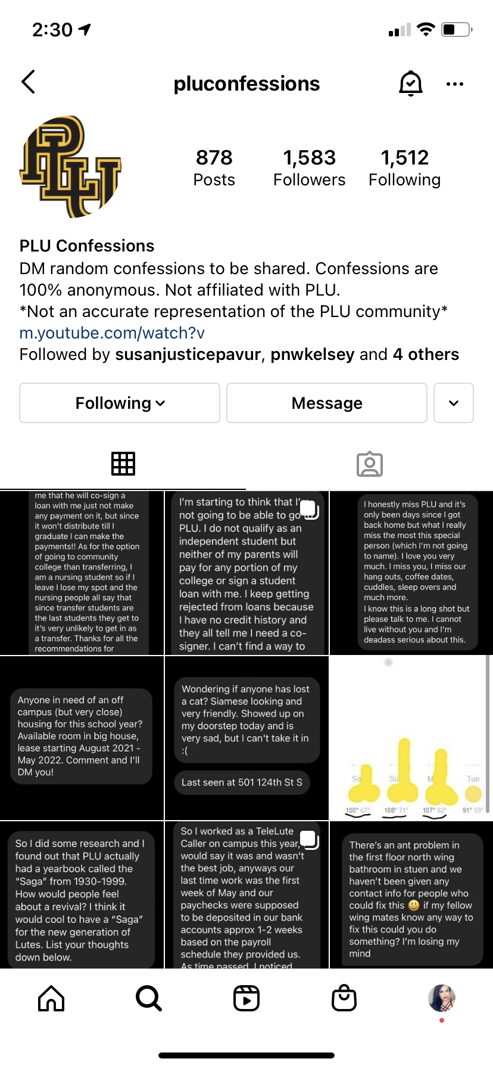
PLU Confessions IG Page
Subtitle
Students submit anonymous “confessions” that relate to the university
Is not regulated or monitored by PLU
Must adhere to the Community Standards of IG, but still may break PLU policy at some point

Slide 16
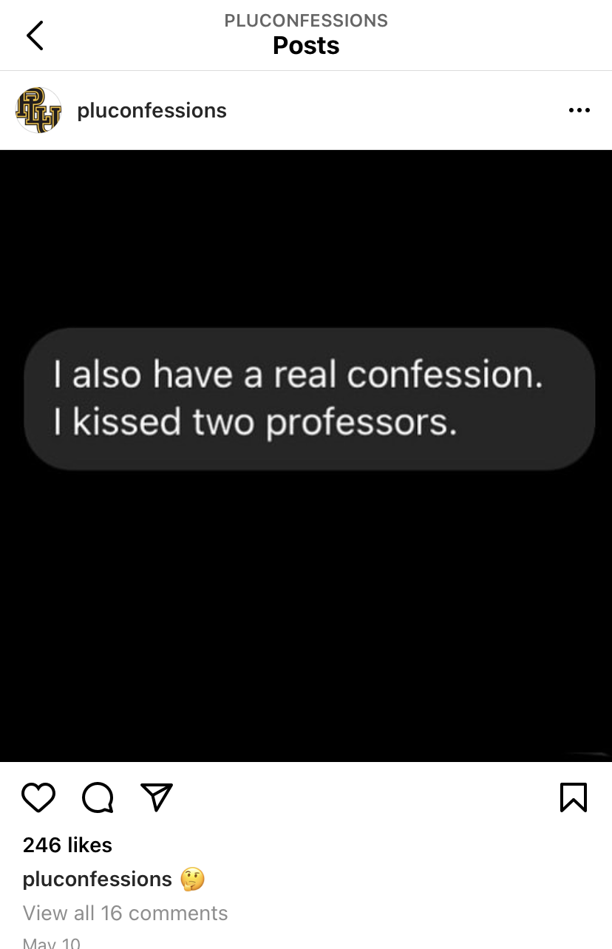
PLU Confessions Example
Subtitle

Slide 17
Positive Social Media Impact
Social Media can have a positive impact on Title IX related issues:
Social media can create awareness on Title IX issues and sexual assault prevention
Social media can foster communities of support
Subtitle

Slide 18
Thank you!
:)

