Slide 1
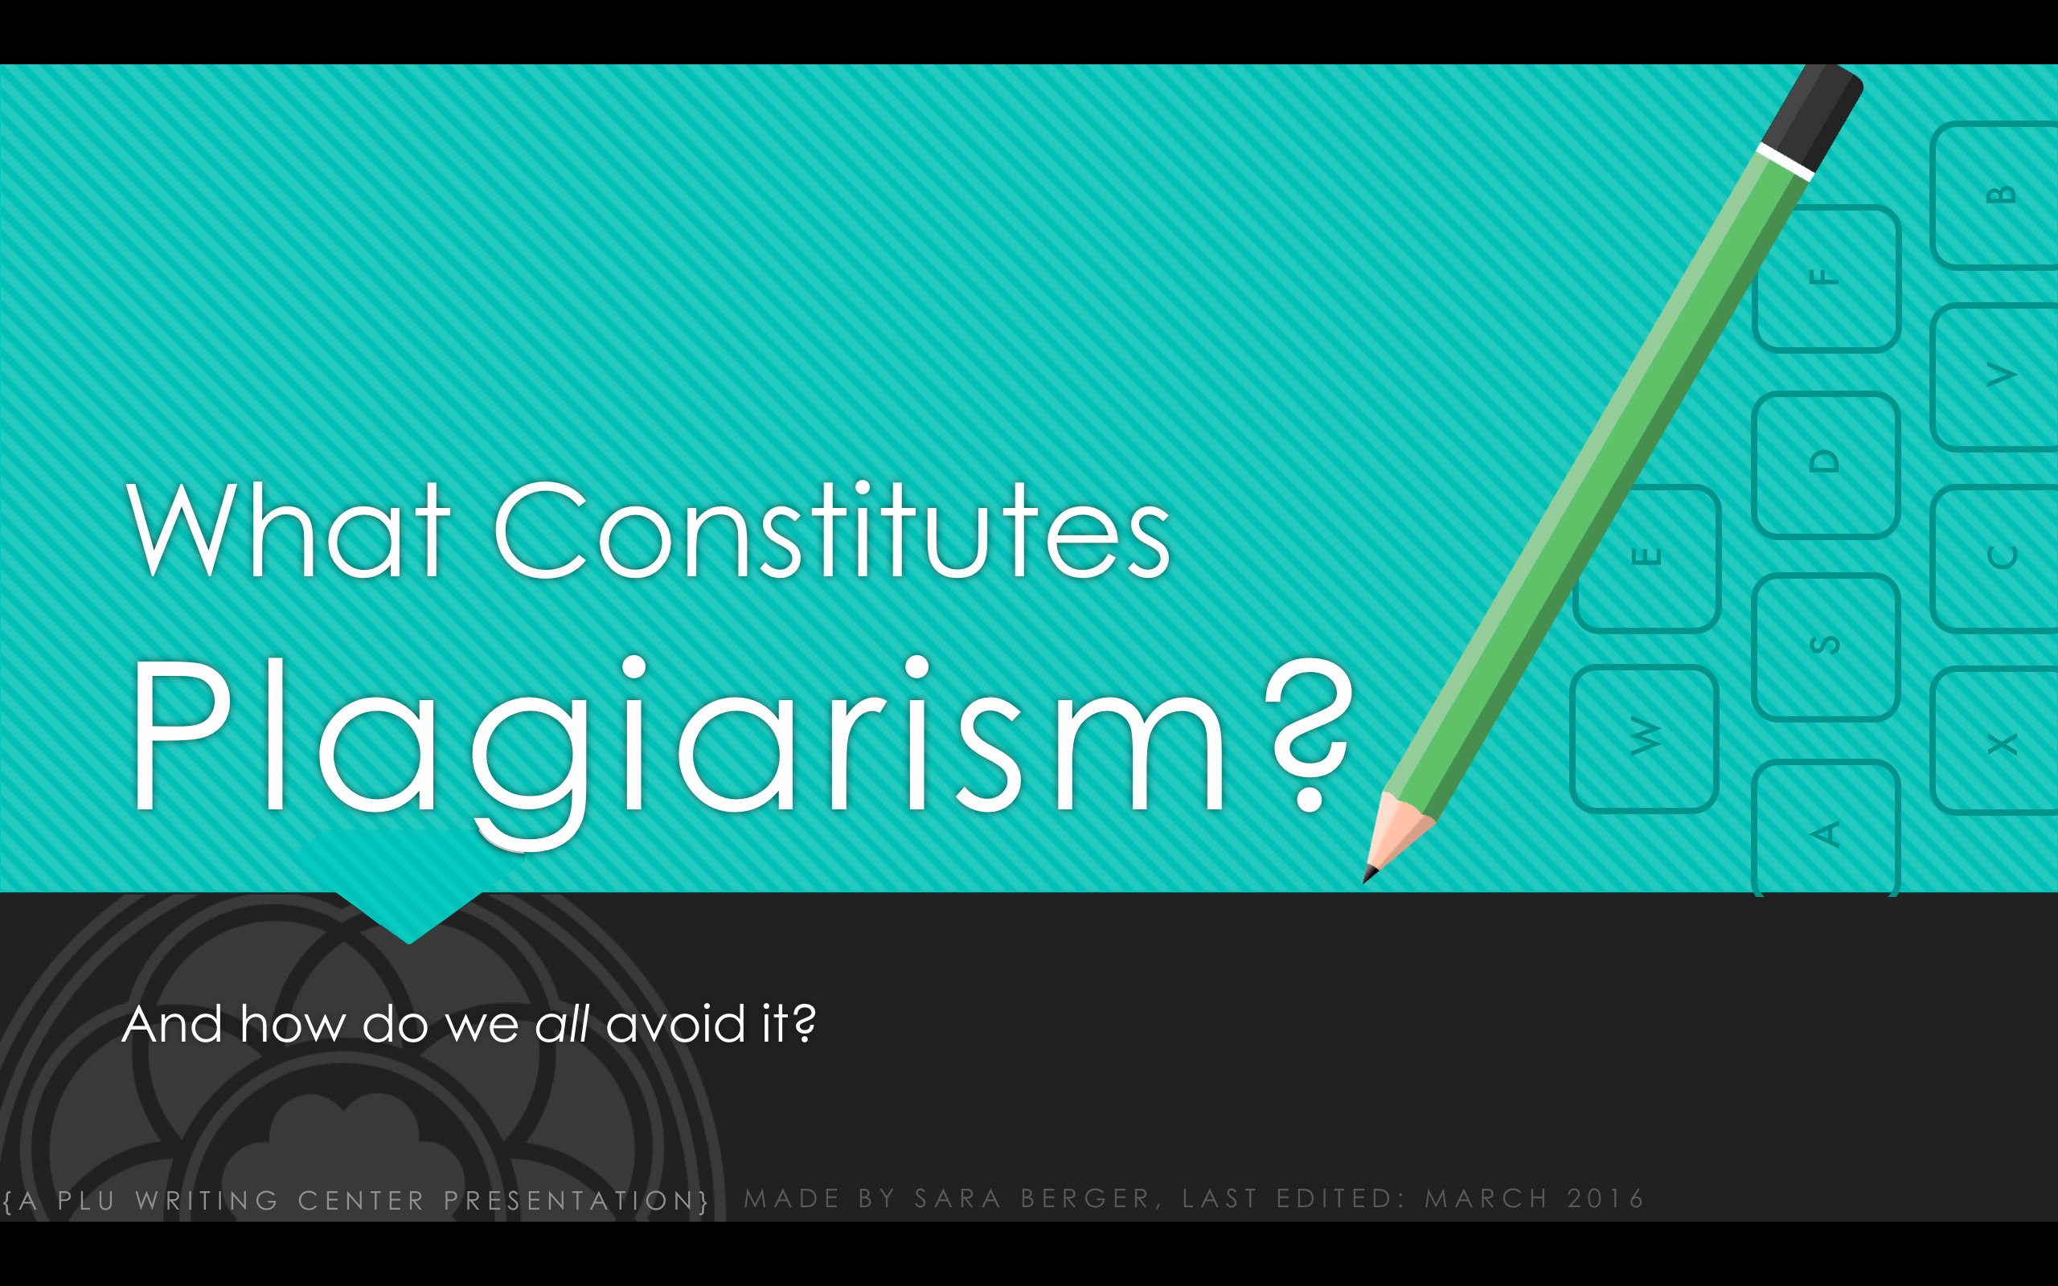

What Constitutes
Plagiarism?
B
F
V
D
E
C
S
W
X
A
And how do we all avoid it?
{A PLU WRITING CENTER PRESENTATION}
MADE BY SARA BERGER, LAST EDITED: MARCH 2016

Slide 2
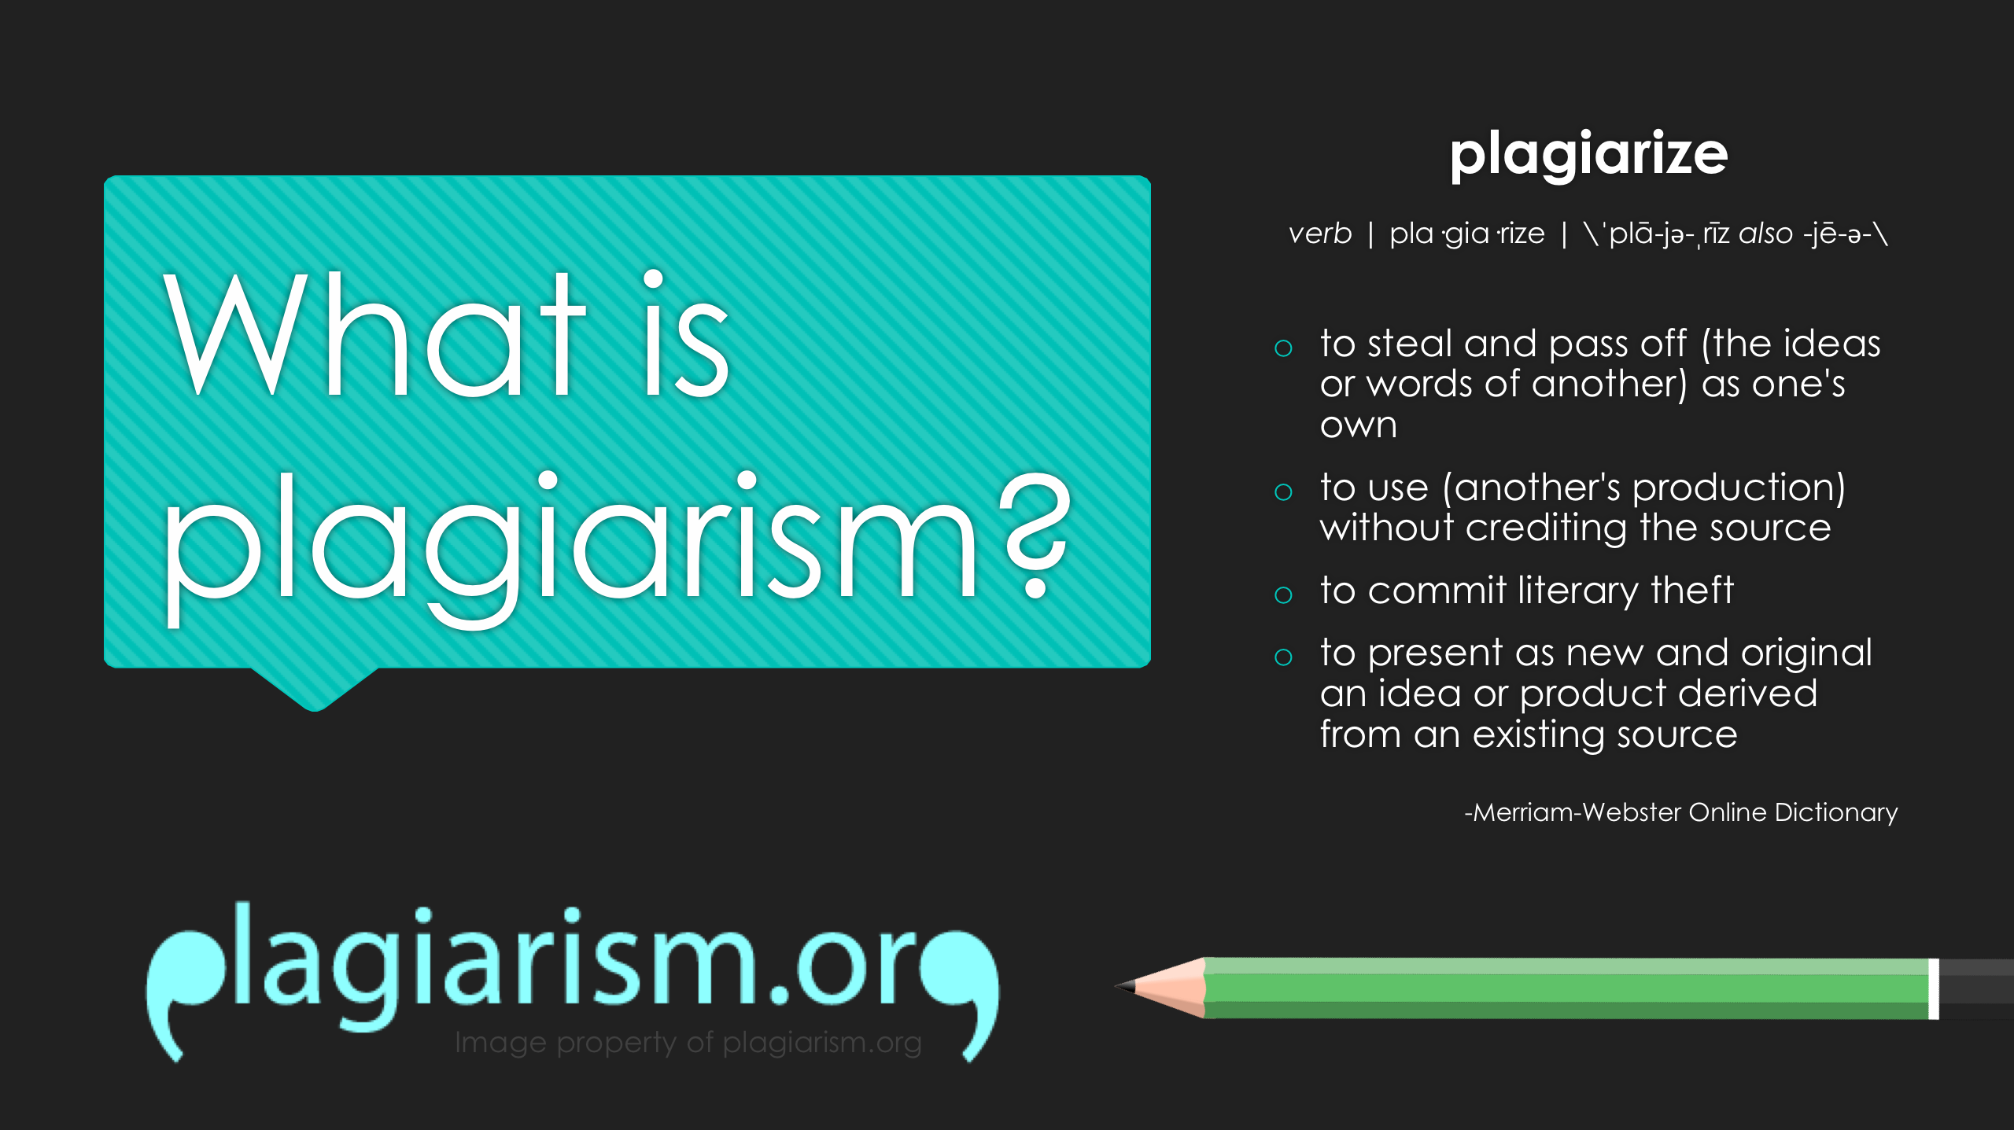
What is plagiarism?
plagiarize
verb | pla·gia·rize | \ˈplā-jə-ˌrīz also -jē-ə-\
to steal and pass off (the ideas or words of another) as one's own
to use (another's production) without crediting the source
to commit literary theft
to present as new and original an idea or product derived from an existing source
-Merriam-Webster Online Dictionary
Image property of plagiarism.org
Notes:
Starting point -
Definite plagiarizing using definitions from the Merriam-Webster Online Dictionary:
to steal and pass off (the ideas or words of another) as one's own
to use (another's production) without crediting the source
to commit literary theft
to present as new and original an idea or product derived from an existing source
NOTE: Let audience know that while this sums up the general definition of plagiarism, we will go into specific examples later.
Mention plagiarism.org to audience as a good resource that helped form this presentation, a place to learn even more about plagiarism, and a starting place search for answers to further more in-depth questions about plagiarism.

Slide 3
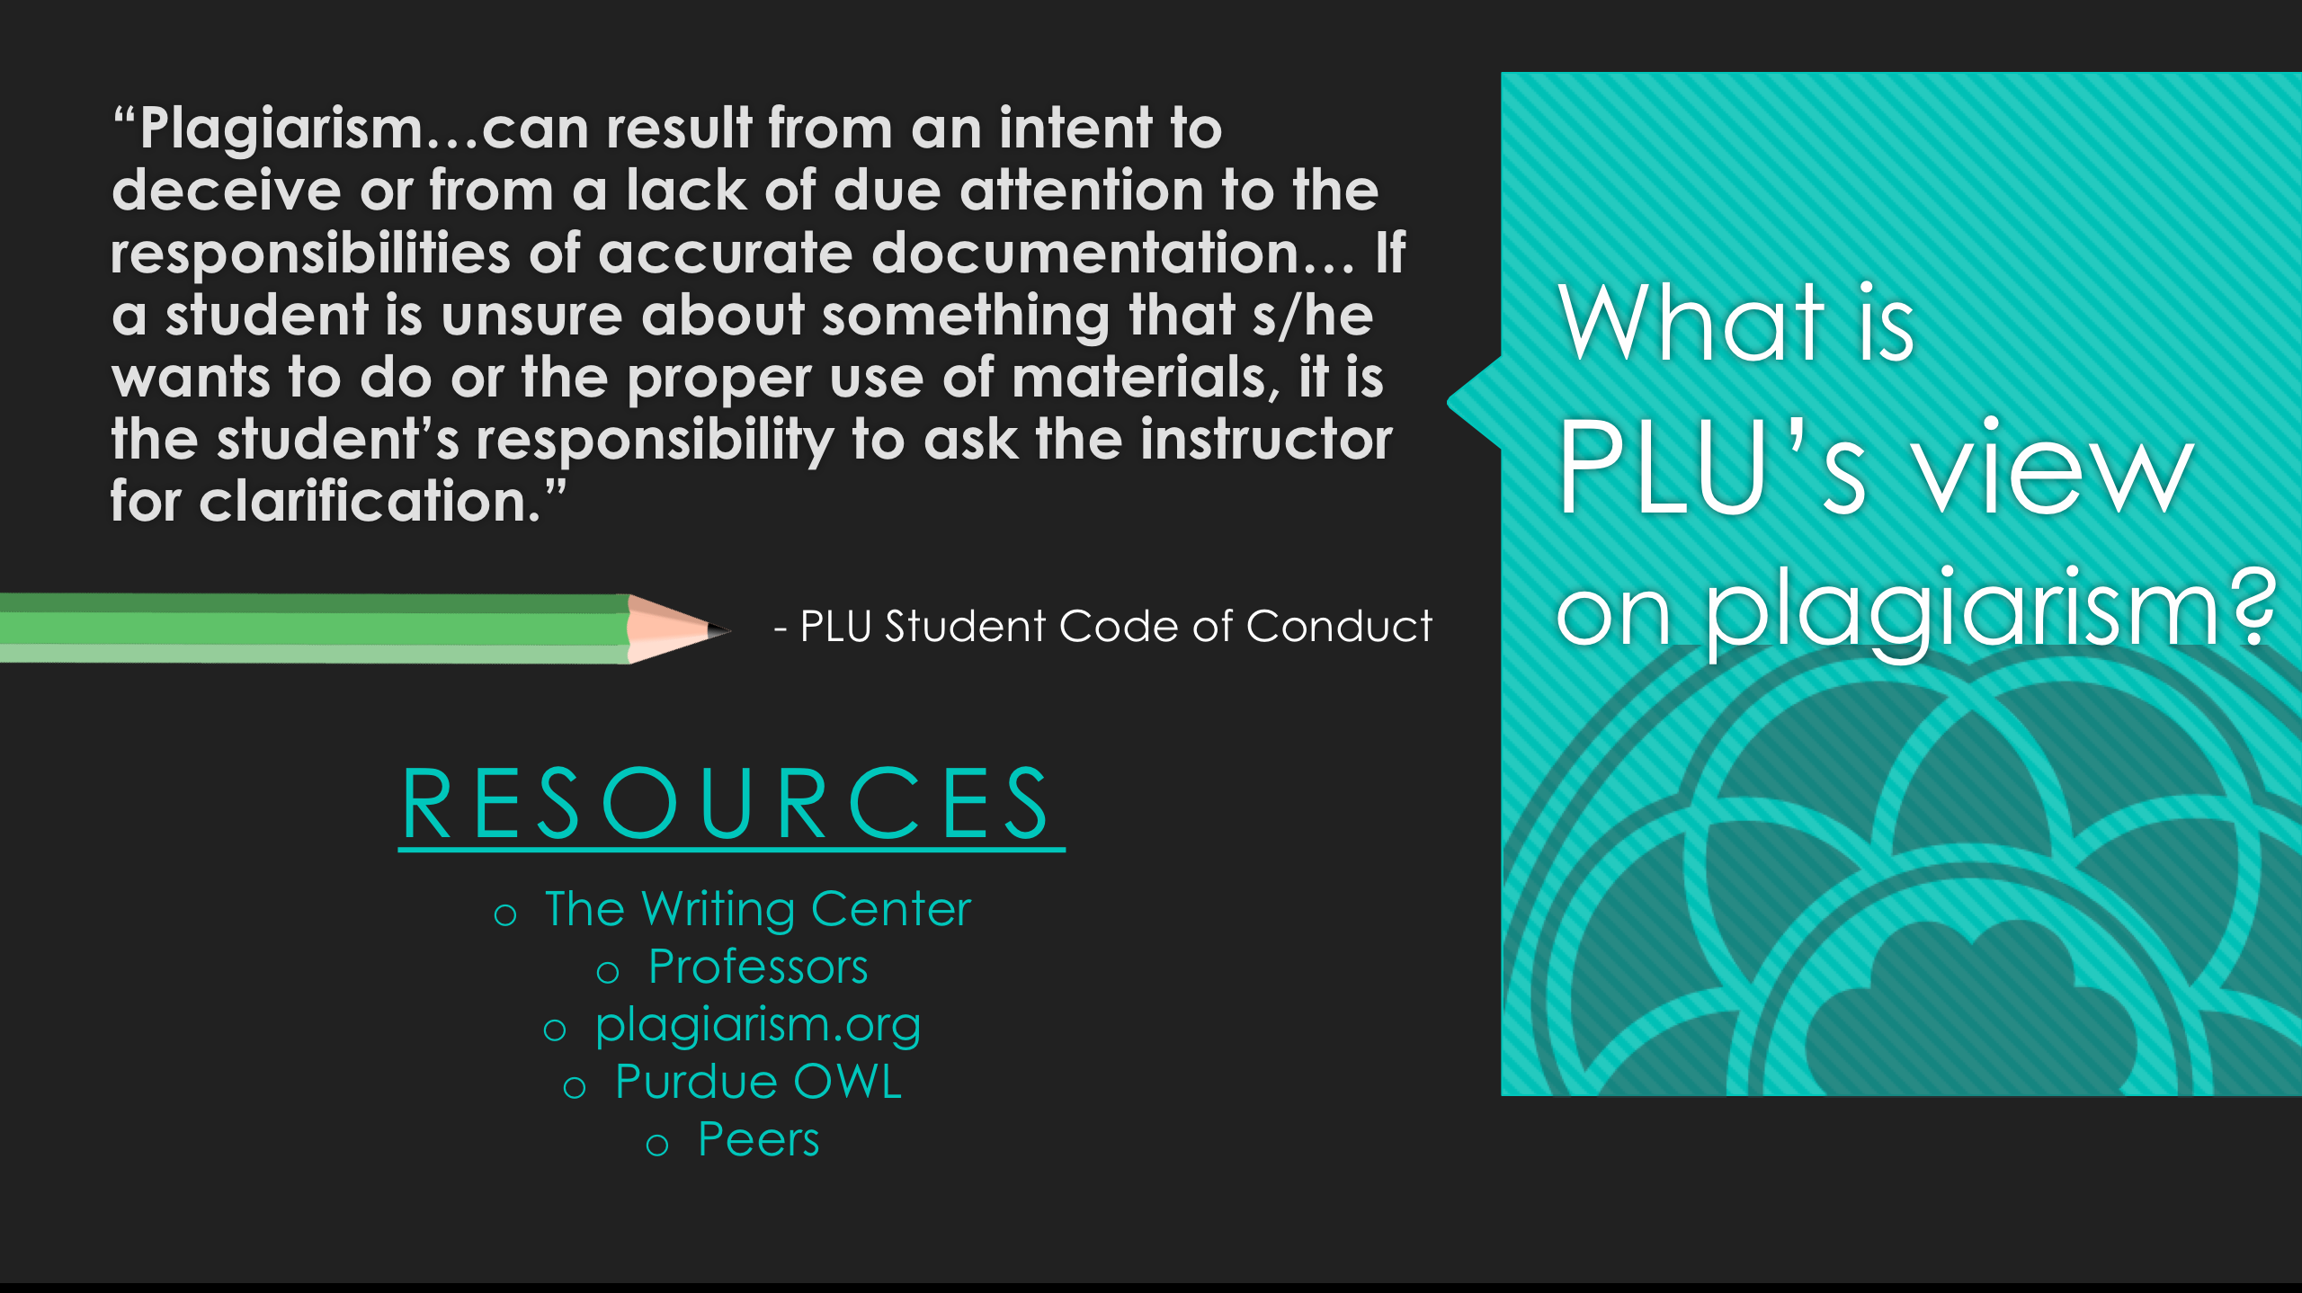

What is
PLU’s view on plagiarism?
“Plagiarism…can result from an intent to deceive or from a lack of due attention to the responsibilities of accurate documentation… If a student is unsure about something that s/he wants to do or the proper use of materials, it is the student’s responsibility to ask the instructor for clarification.”
- PLU Student Code of Conduct
RESOURCES
The Writing Center
Professors
plagiarism.org
Purdue OWL
Peers
Notes:
Notify or reiterate to audience PLU’s attitude towards plagiarism as outlined in the PLU Student Code of Conduct under ‘Academic Integrity’:
“Plagiarism…can result from an intent to deceive or from a lack of due attention to the responsibilities of accurate documentation… If a student is unsure about something that s/he wants to do or the proper use of materials, it is the student’s responsibility to ask the instructor for clarification.”
WHAT DOES THAT MEAN?
Plagiarism is not always the result of ill-willed people, it can be a mistake
HOWEVER, it always ends up being our responsibility as students to avoid plagiarism: no one else’s.
Even though it’s our responsibility, there are resources to help sort everything out including:
The Writing Center (NOTE: this contact information will be up at the end of the presentation)
Professors
plagiarism.org
Purdue OWL
Peers
THIS IS NOT ONLY PLU POLICY, BUT FEDERAL LAW.
”Most cases of plagiarism are considered misdemeanors, punishable by fines of anywhere between $100 and $50,000 -- and up to one year in jail.” – plagiarism.org
“Expression of original ideas is considered intellectual property and is protected by copyright laws, just like original inventions. Almost all forms of expression fall under copyright protection as long as they are recorded in some way (such as a book or a computer file).” – plagiarism.org

Slide 4
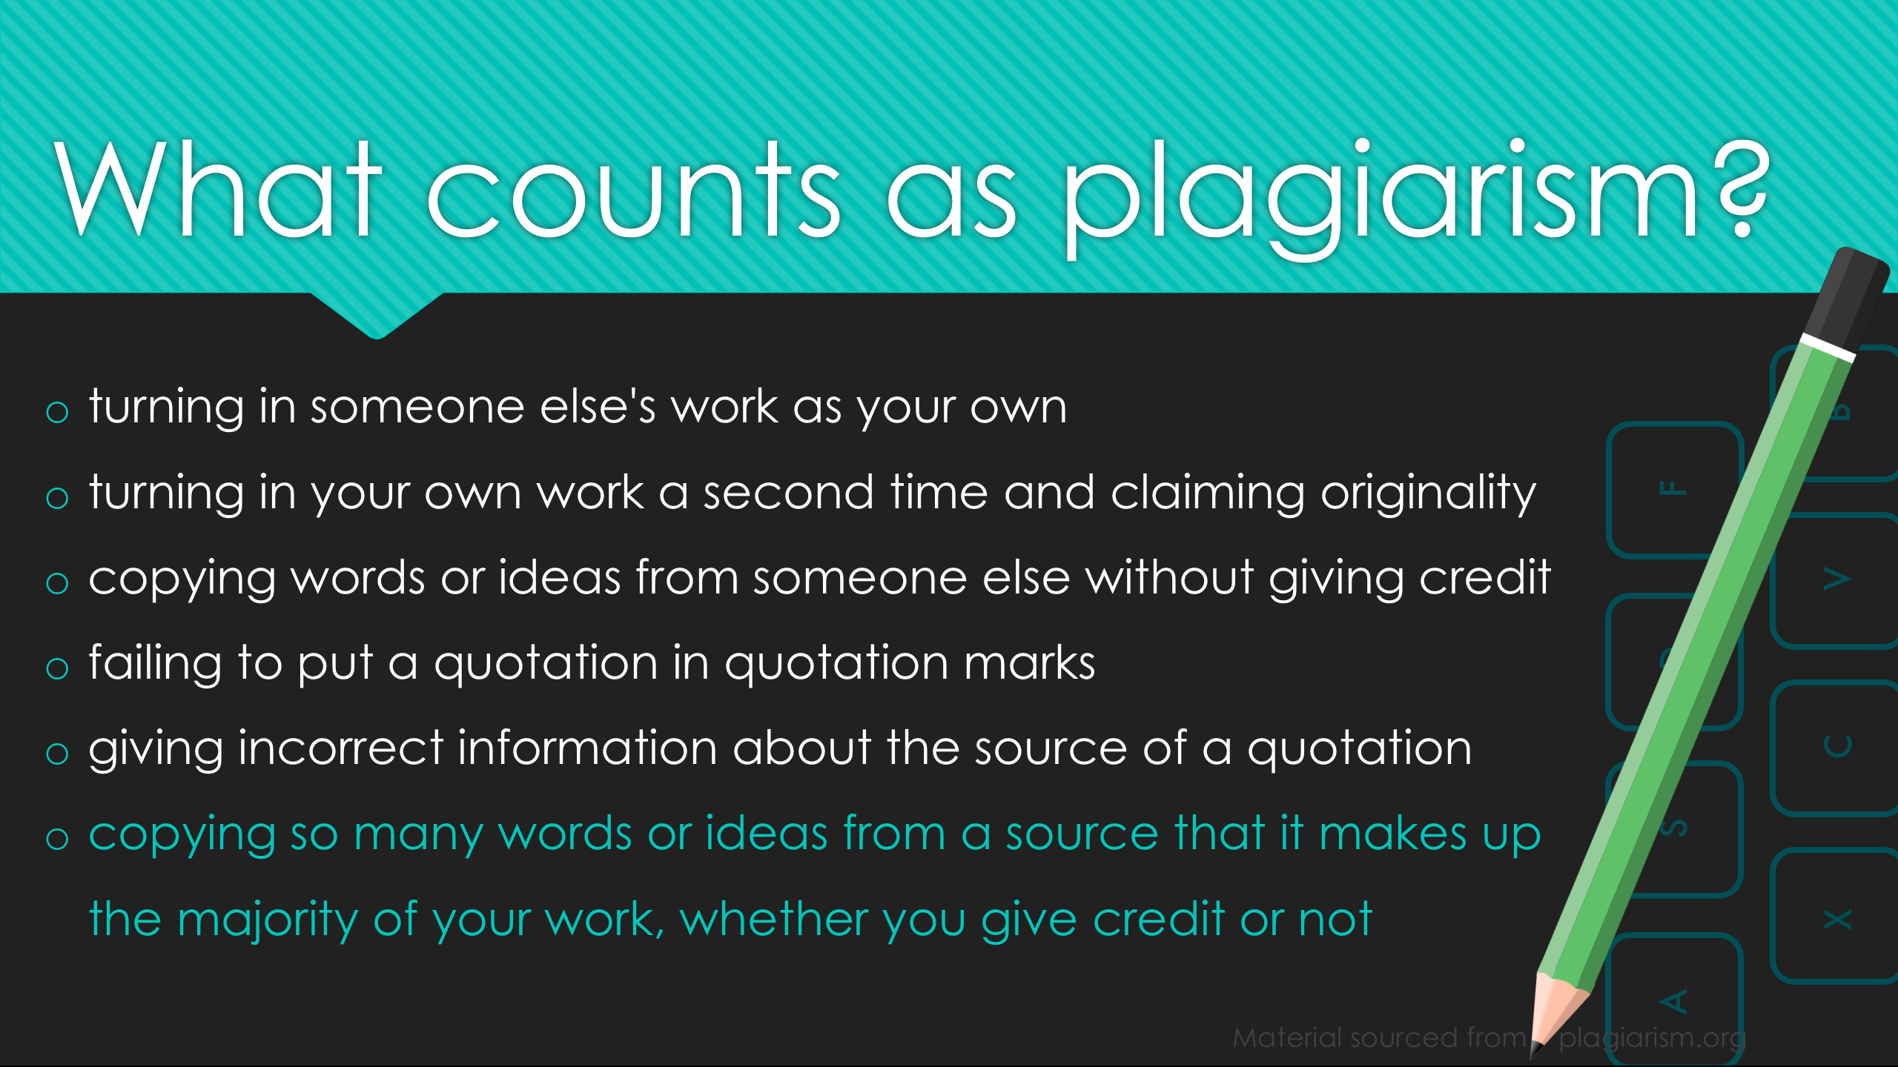
What counts as plagiarism?
turning in someone else's work as your own
turning in your own work a second time and claiming originality
copying words or ideas from someone else without giving credit
failing to put a quotation in quotation marks
giving incorrect information about the source of a quotation
copying so many words or ideas from a source that it makes up
the majority of your work, whether you give credit or not
B
F
V
D
C
S
X
A
Material sourced from plagiarism.org
Notes:
Many of the main, knowing or unknowing, offenses of plagiarism come from:
turning in someone else's work as your own
turning in your own work a second time and claiming originality
AKA: Don’t resubmit work from another class to fulfill requirements for a similar paper on the same subject
copying words or ideas from someone else without giving credit
failing to put a quotation in quotation marks
giving incorrect information about the source of a quotation
copying so many words or ideas from a source that it makes up
the majority of your work, whether you give credit or not
THIS INCLUDES MUSIC, MEDIA, AND IMAGES
NOTE: Almost all of these offenses of plagiarism can be avoided with proper documentation and citation. However, even when people try their best to cite properly and not plagiarize, problems can arise (LEAD INTO PATCHWRITING).

Slide 5
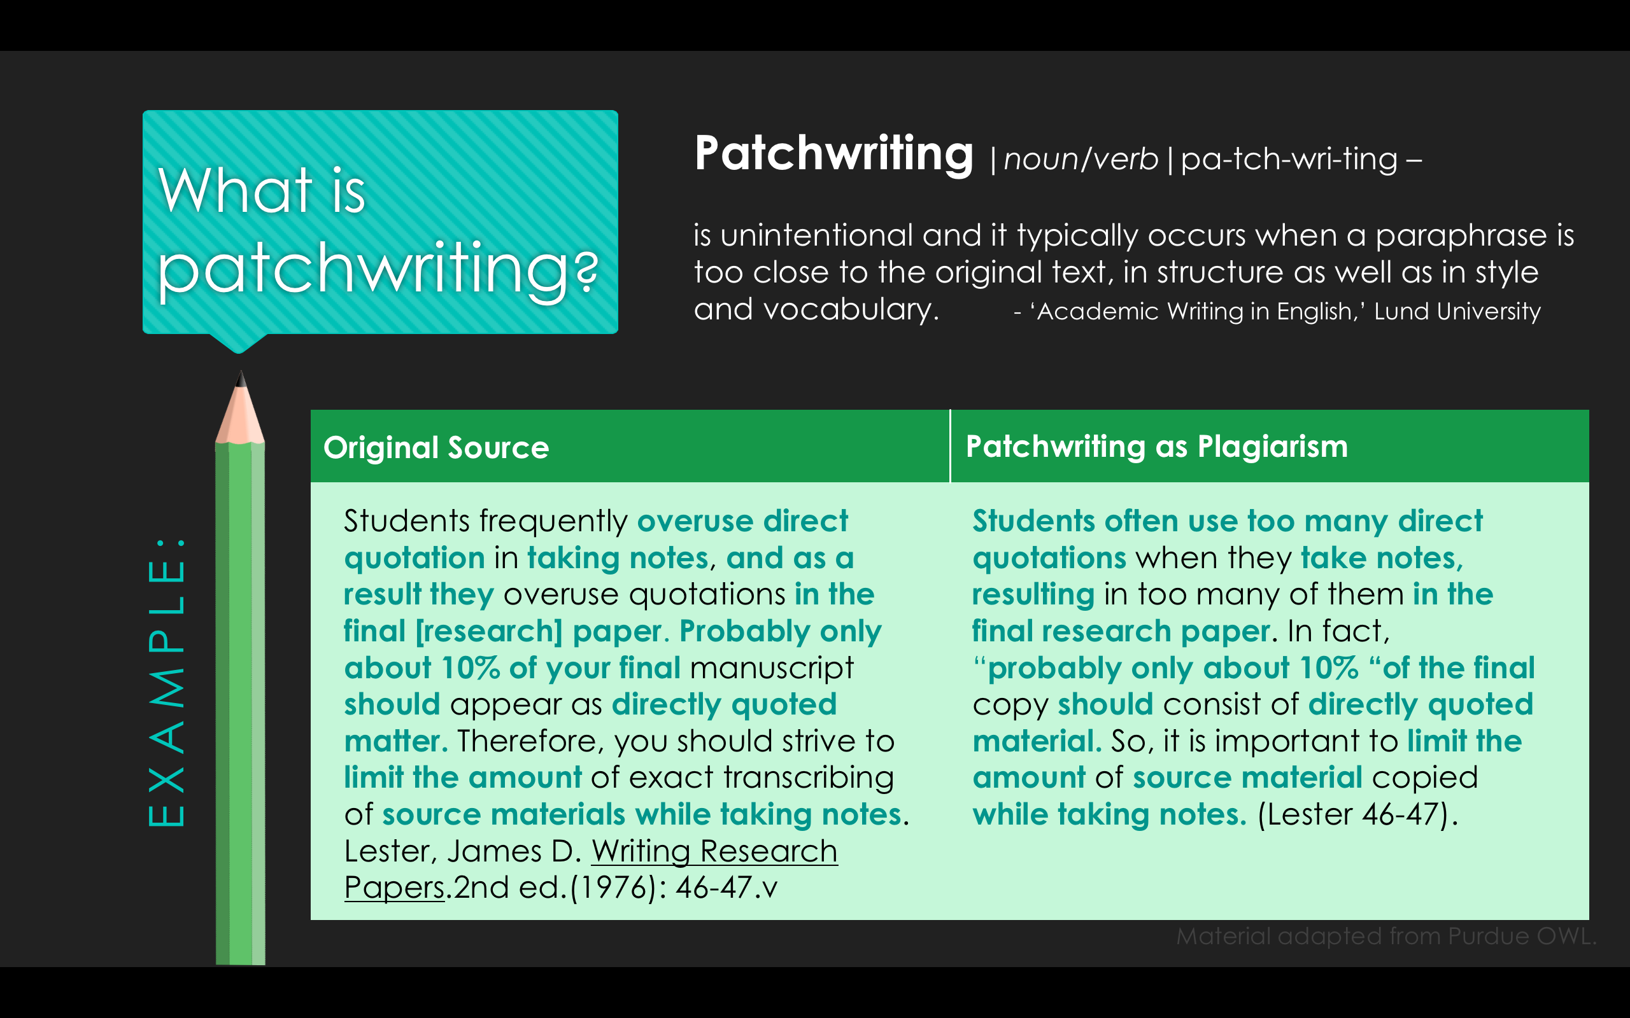
What is patchwriting?
Patchwriting |noun/verb|pa-tch-wri-ting –
is unintentional and it typically occurs when a paraphrase is too close to the original text, in structure as well as in style and vocabulary. - ‘Academic Writing in English,’ Lund University
Original Source
Patchwriting as Plagiarism
Students frequently overuse direct quotation in taking notes, and as a result they overuse quotations in the final [research] paper. Probably only about 10% of your final manuscript should appear as directly quoted matter. Therefore, you should strive to limit the amount of exact transcribing of source materials while taking notes. Lester, James D. Writing Research Papers.2nd ed.(1976): 46-47.v
Students often use too many direct quotations when they take notes, resulting in too many of them in the final research paper. In fact, “probably only about 10% “of the final copy should consist of directly quoted material. So, it is important to limit the amount of source material copied while taking notes. (Lester 46-47).
EXAMPLE:
Material adapted from Purdue OWL.
Notes:
Problem mentioned in previous slide:
“copying so many words or ideas from a source that it makes up the majority of your work, whether you give credit or not"
Patchwriting definition, from Lund University:
“Patchwriting is unintentional and it typically occurs when a paraphrase is too close to the original text, in structure as well as in style and vocabulary.”
NOTE: Patchwriting also occurs when a multitude of short unexplained quotations build up the bulk of the writing. You can incorporate short quotes into your own sentences, but it must be clear what is coming from you and what is sourced material, and the ideas need to amount to being your own, not just a summary of the original authors.
When does patchwriting occur?
When writers do not analyze thoroughly
Synonyms are used to replace words, and writers stop there
KEEP IN MIND: Some inclusion of other’s ideas is perfectly fine, it is when it becomes the majority of your work that it’s a problem. However, if you do notice that your writing is built up of mostly patchwriting, or your paper is mostly filled with ideas that aren’t yours in general, be glad that you did notice, and take that as a sign to add more of your own argument or analysis to your paper.

Slide 6
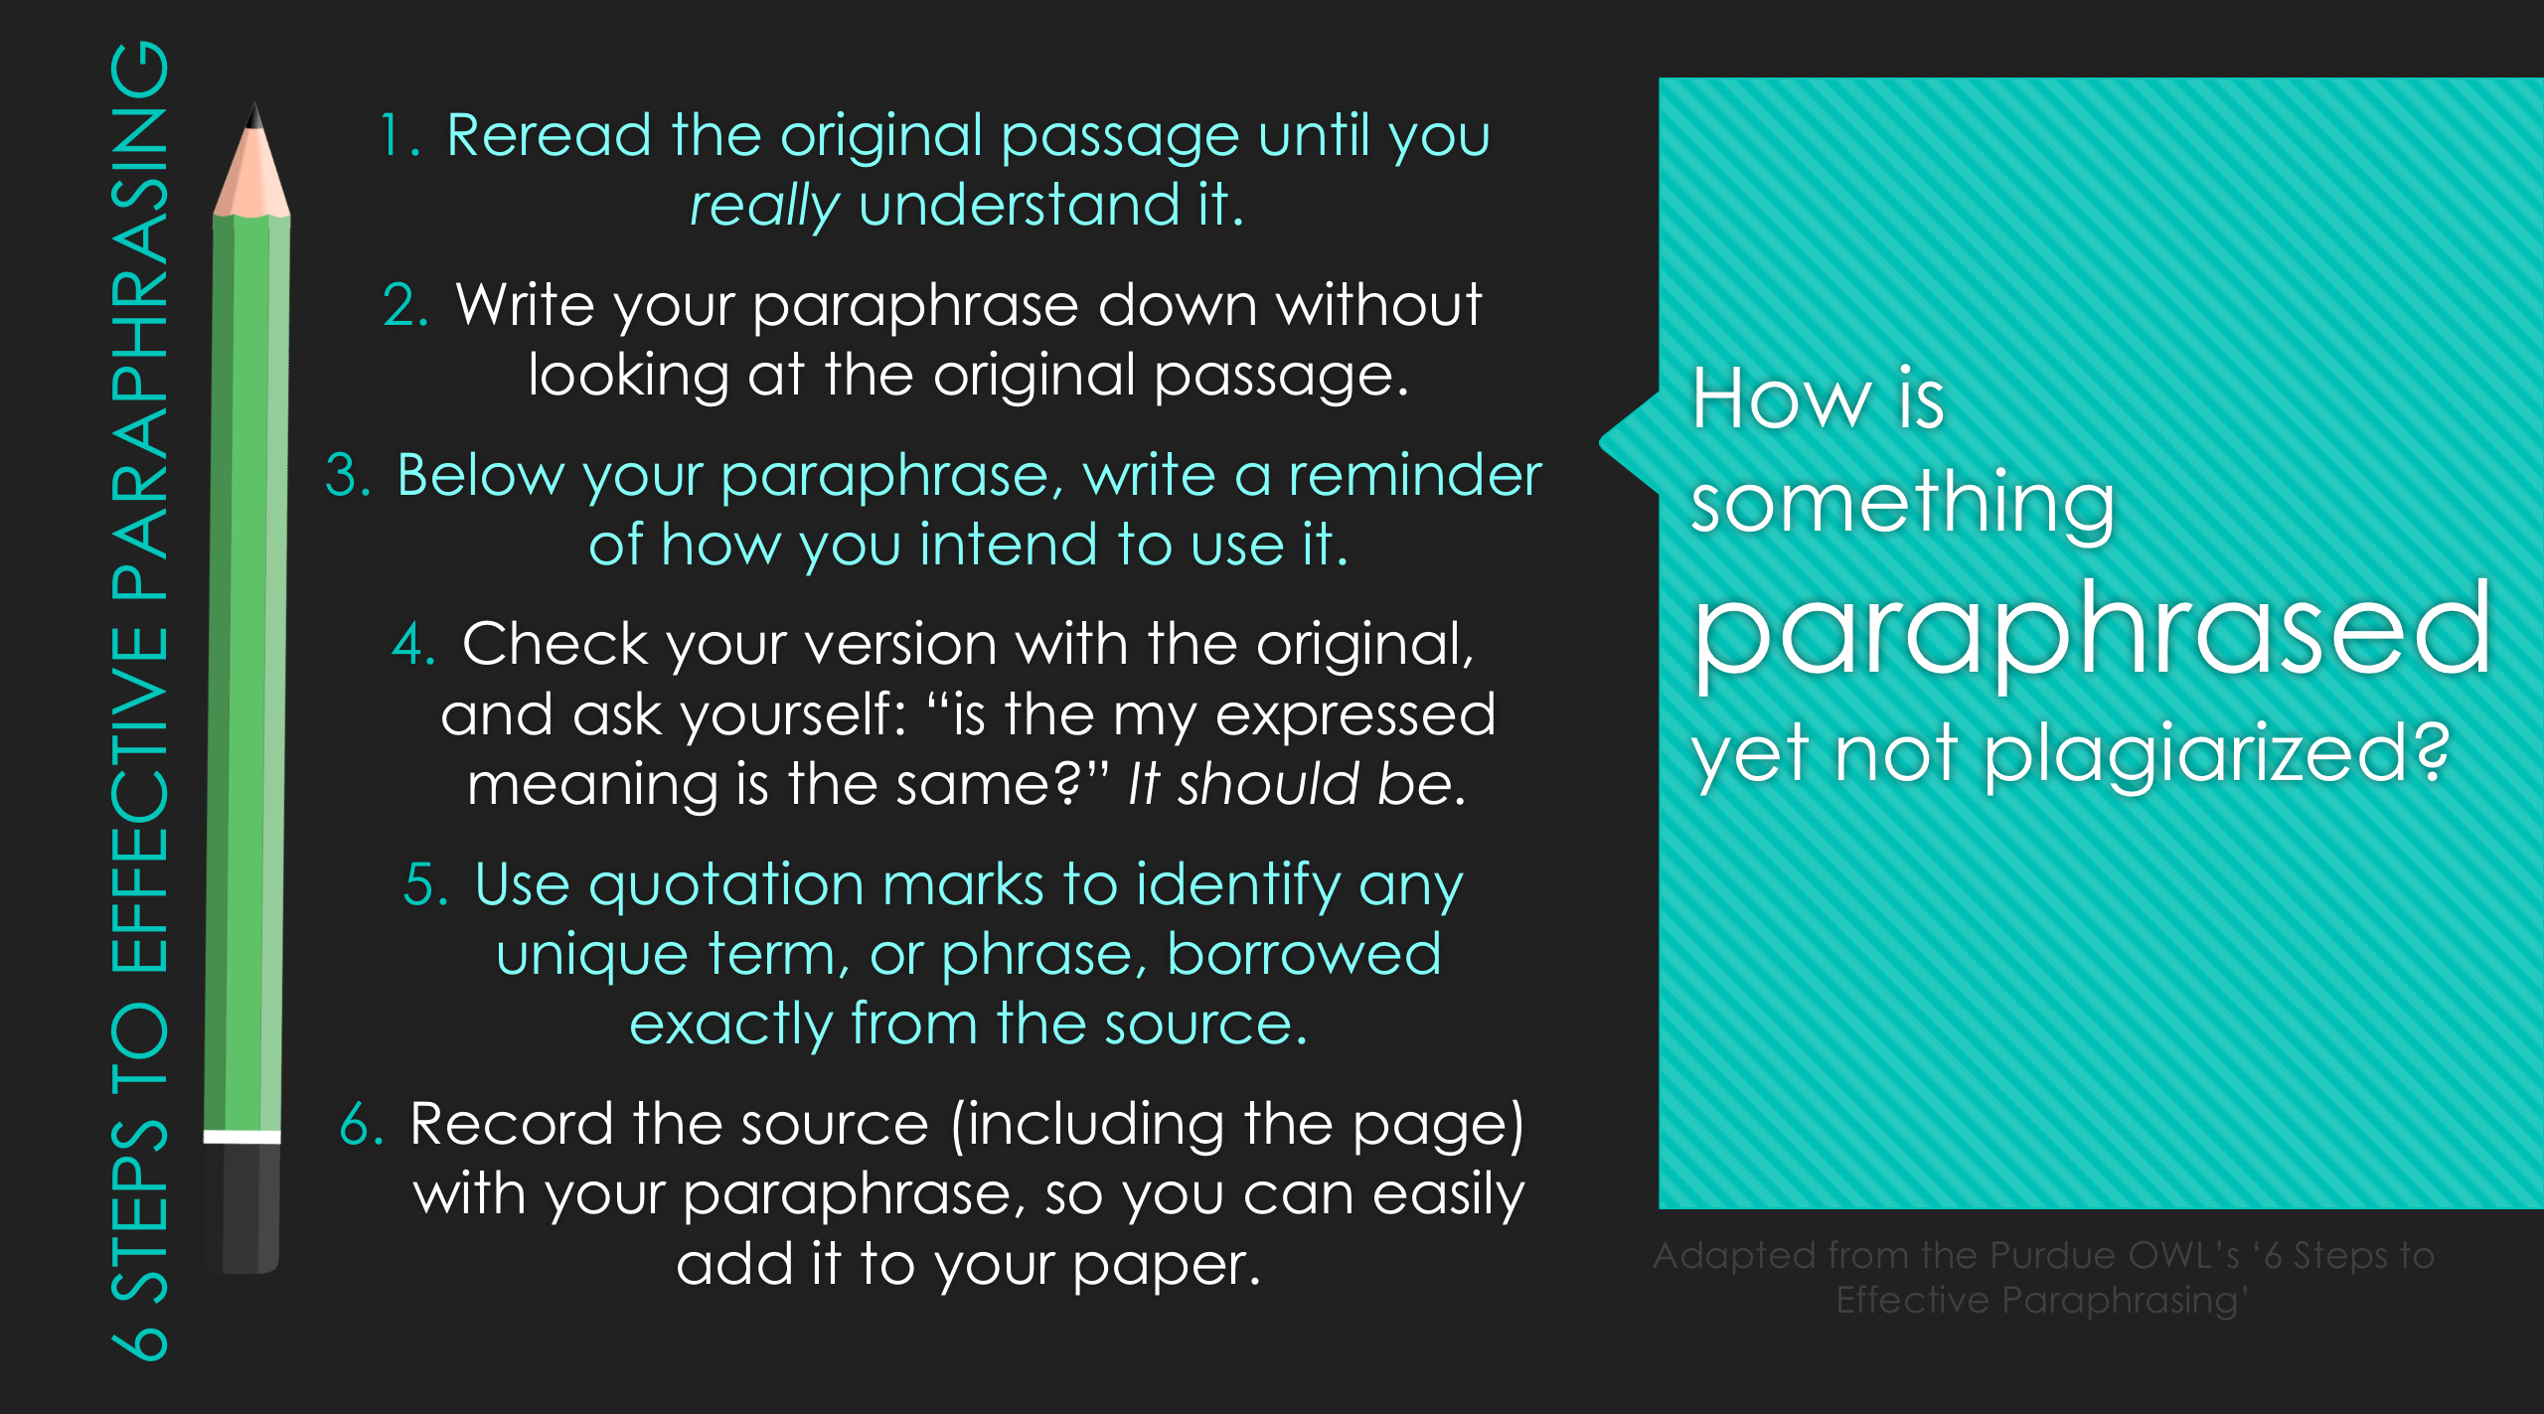
How is something paraphrased yet not plagiarized?
Reread the original passage until you really understand it.
Write your paraphrase down without looking at the original passage.
Below your paraphrase, write a reminder of how you intend to use it.
Check your version with the original, and ask yourself: “is the my expressed meaning is the same?” It should be.
Use quotation marks to identify any unique term, or phrase, borrowed exactly from the source.
Record the source (including the page) with your paraphrase, so you can easily add it to your paper.
6 STEPS TO EFFECTIVE PARAPHRASING
Adapted from the Purdue OWL’s ‘6 Steps to Effective Paraphrasing’
Notes:
According to the Purdue OWL, a paraphrase is your own rendition of essential information and ideas expressed by someone else, presented in a new form, and a more detailed restatement than a summary, which focuses concisely on a single main idea.
Here are ‘6 Steps to Effective Paraphrasing,’ adapted from the six steps listed on the Purdue OWL:
Reread the original passage until you genuinely understand it.
Understanding means you can interact with the text.
Write your paraphrase down without looking at the original passage.
This will help avoid patchwriting, because you can’t rely on the original author’s words.
Below your paraphrase, write a reminder of how you intend to use it.
Organization will help keep you working efficiently.
Check your version with the original, and ask yourself: “is the my expressed meaning is the same?” It should be.
If the meaning is different, you are misrepresenting your original source and leading your reader astray.
Use quotation marks as needed to identify any unique term, or phrase, borrowed exactly from the source.
This is important in assuring you are really paraphrasing, not plagiarizing.
Record the source (including the page) with your paraphrase, so you can easily add it to your paper.
We’ve all probably spent 10 minutes for a source, so just do this in the first place and save yourself time.

Slide 7
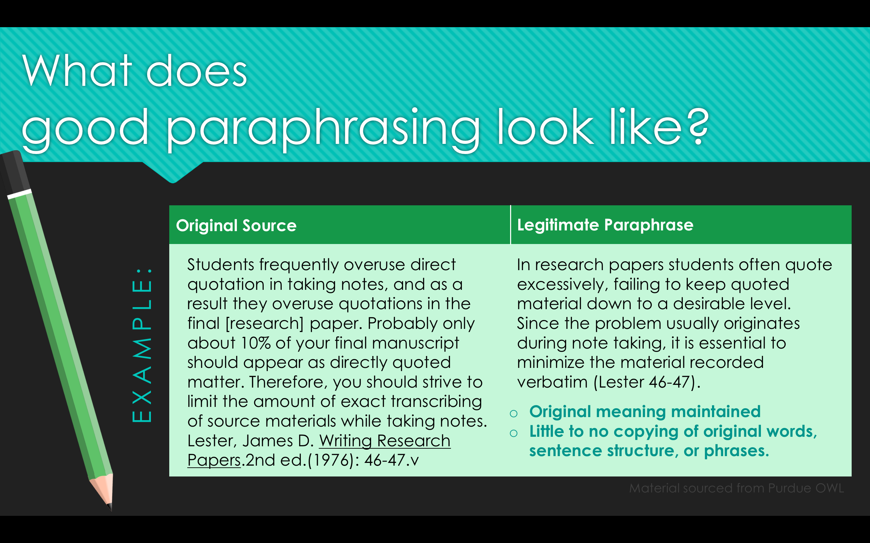
What does good paraphrasing look like?
Original Source
Legitimate Paraphrase
Students frequently overuse direct quotation in taking notes, and as a result they overuse quotations in the final [research] paper. Probably only about 10% of your final manuscript should appear as directly quoted matter. Therefore, you should strive to limit the amount of exact transcribing of source materials while taking notes. Lester, James D. Writing Research Papers.2nd ed.(1976): 46-47.v
In research papers students often quote excessively, failing to keep quoted material down to a desirable level. Since the problem usually originates during note taking, it is essential to minimize the material recorded verbatim (Lester 46-47).
EXAMPLE:
Original meaning maintained
Little to no copying of original words, sentence structure, or phrases.
Material sourced from Purdue OWL
Notes:
Let audience know why paraphrasing is important, that it’s perfectly okay, and what a good example looks like:
From plagiarism.org unless ***in asterisks***:
The purpose of paraphrasing is not to make it seem like you are drawing less directly from other sources or to reduce the number of quotations in your paper. ***Although paraphrasing does help cut down on rampant and overly distracting quoting***
It is a common misconception that you need to hide the fact that you rely on other sources. Actually it is advantageous to highlight the fact that other sources support your own ideas. Using quality sources to support your ideas makes them seem stronger and more valid.
Good paraphrasing makes the ideas of the original source fit smoothly into your paper, emphasizing the most relevant points and leaving out unrelated information. ***And helps you avoid plagiarism and academic discipline***
NOTE: Don’t forget to discuss on-screen example before moving on to next slide. Why is this a good example?:
Original meaning maintained – this author isn’t leading their readers astray or misrepresenting the information
Little to no copying of original words, sentence structure, or phrases. – AKA: it isn’t patchwriting that becomes plagiarism.

Slide 8
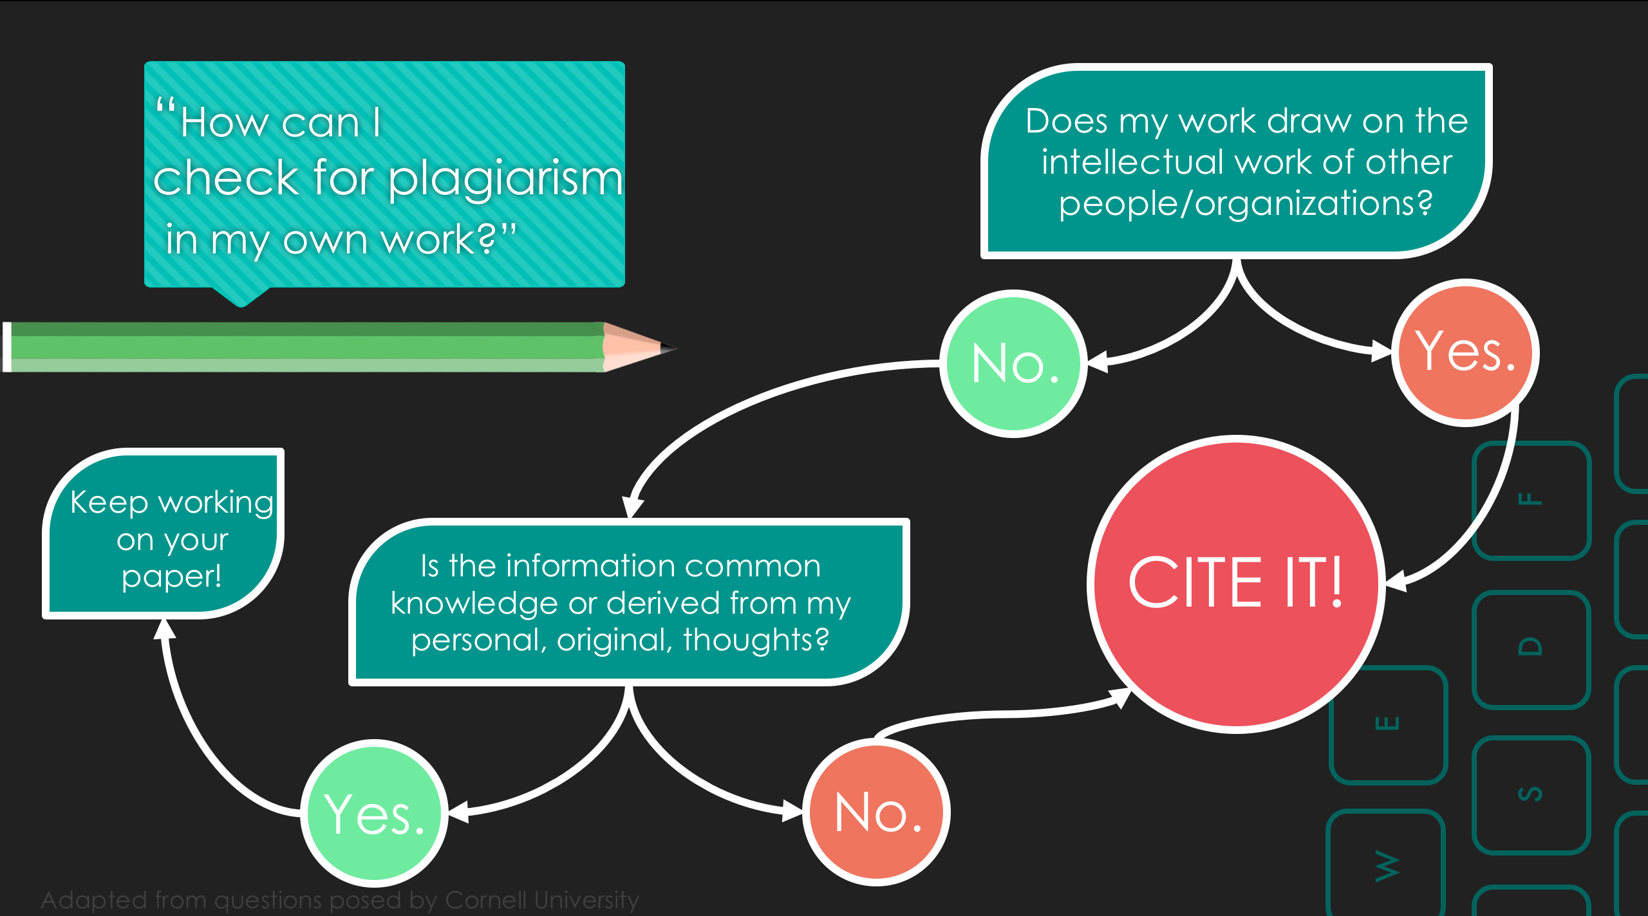
“How can I check for plagiarism in my own work?”
Does my work draw on the intellectual work of other people/organizations?
No.
Yes.
Keep working on your paper!
F
Is the information common knowledge or derived from my personal, original, thoughts?
CITE IT!
D
E
Yes.
No.
S
W
Adapted from questions posed by Cornell University
A
Notes:
Now that the audience is familiar with documentation, explain how they can check their own work for plagiarism:
First ask yourself: Does my work draw on the intellectual work of other people/organizations?
Depending on that answer, you can either add a citation to avoid plagiarism, or move on in working on your paper.
This flowchart is a condensed version of a larger one that can be shared with the audience.
NOTE: As time allows, describe the difference between a common knowledge fact, or one from an individual source.
EX: The United States is on a different continent than France VS. People in the United States eat significantly more fast food than French people. (Is this true? Probably, but I just made it up. If it is true, it needs a citation to show where the information came from and validate using it as evidence for whatever argument you’re making.)

Slide 9
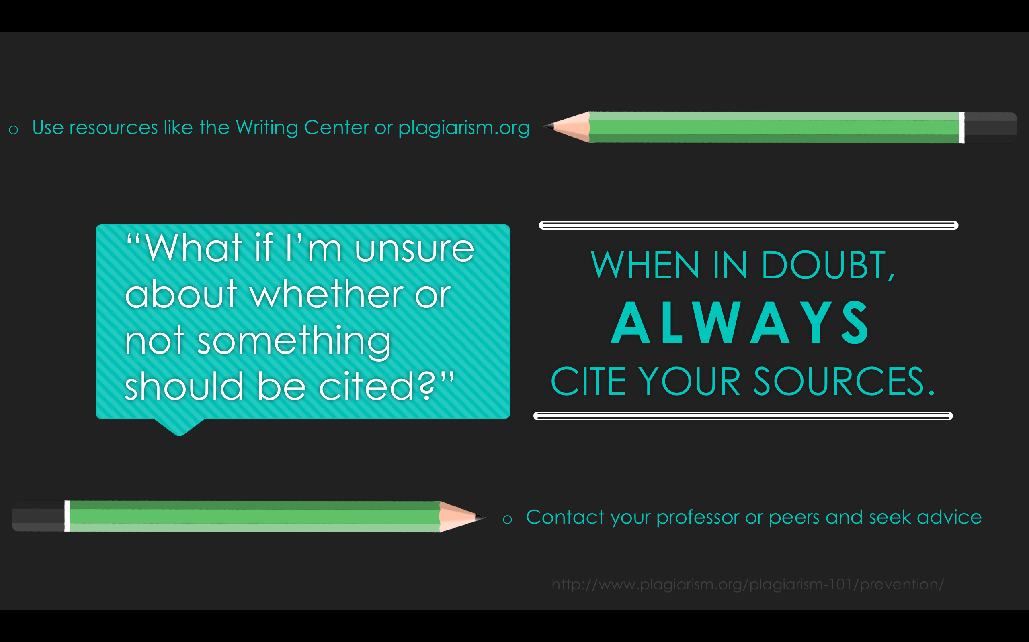
“What if I’m unsure about whether or not something should be cited?”
Use resources like the Writing Center or plagiarism.org
WHEN IN DOUBT,
ALWAYS
CITE YOUR SOURCES.
Contact your professor or peers and seek advice
http://www.plagiarism.org/plagiarism-101/prevention/
Notes:
Chances are, if you’re questioning whether or not you should cite something you probably should just do it.
DON’T FORGET: Citation styles differ from class to class, and even paper to paper, so make sure you know what you should be using, be it APA, MLA, Chicago, or something else, and make sure you are using it correctly. The same resources for plagiarism can be utilized to help with citation.
In short:
Plagiarism isn’t always malicious, but it is always avoidable.
Don’t be afraid to ask for help regarding citations or plagiarism, and do it early.
Patchwriting occasionally works, but to avoid plagiarism, always check how much of the content is yours vs. your source’s.
Paraphrasing can be tricky, make sure to practice and carefully analyze what you’ve written (LEAD INTO ACTIVITY or WRITING CENTER SLIDE).

Slide 10

What are the easiest ways to contact the Writing Center?
VISIT:
Library 220
CALL:
253-535-8709
E-MAIL:
writing@plu.edu
HOURS: Spring 2016-
Mon-Thurs: 9a to 9p
Friday: 9a to 1p
Sunday: 4p to 9p
Notes:
***Put this slide up while the class is working on the worksheet associated with the presentation, or while questions are being asked if no worksheet is distributed***

Slide 11
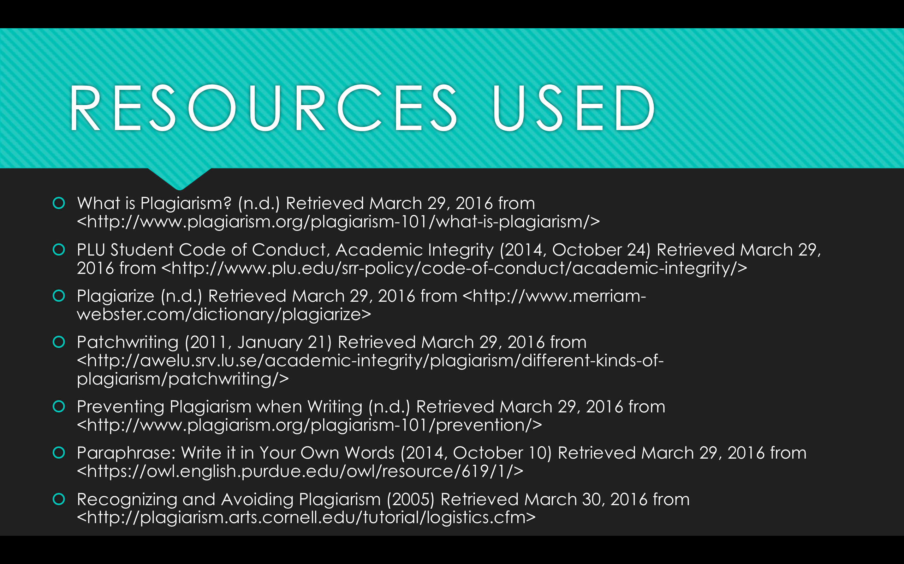
RESOURCES USED
What is Plagiarism? (n.d.) Retrieved March 29, 2016 from <http://www.plagiarism.org/plagiarism-101/what-is-plagiarism/>
PLU Student Code of Conduct, Academic Integrity (2014, October 24) Retrieved March 29, 2016 from <http://www.plu.edu/srr-policy/code-of-conduct/academic-integrity/>
Plagiarize (n.d.) Retrieved March 29, 2016 from <http://www.merriam-webster.com/dictionary/plagiarize>
Patchwriting (2011, January 21) Retrieved March 29, 2016 from <http://awelu.srv.lu.se/academic-integrity/plagiarism/different-kinds-of-plagiarism/patchwriting/>
Preventing Plagiarism when Writing (n.d.) Retrieved March 29, 2016 from <http://www.plagiarism.org/plagiarism-101/prevention/>
Paraphrase: Write it in Your Own Words (2014, October 10) Retrieved March 29, 2016 from <https://owl.english.purdue.edu/owl/resource/619/1/>
Recognizing and Avoiding Plagiarism (2005) Retrieved March 30, 2016 from <http://plagiarism.arts.cornell.edu/tutorial/logistics.cfm>

